Slide 1


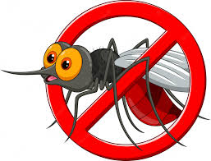
Institute of
Informatics &
Communication
Dengue analysis
Tiya
Research Scholar
IIC, UDSC
CPS Lab, Institute of Informatics and Communication, UDSC

Slide 2
Dengue cases from 2015-2022(April)
According to National Center for vector bourne disease control,Ministry of health and family welfare ,government of india,shows the report of dengue cases and death in india since 2015
https://nvbdcp.gov.in/index4.php?lang=1&level=0&linkid=431&lid=3715
Scraping data and analyze the dengue incidence from 2015-2022 by region
File code : https://colab.research.google.com/drive/169VbY42E2zXrl1j-tL44e01qdNjAwuOZ#scrollTo=hnzv9w4EPFOk
CPS Lab, Institute of Informatics and Communication, UDSC

Slide 3
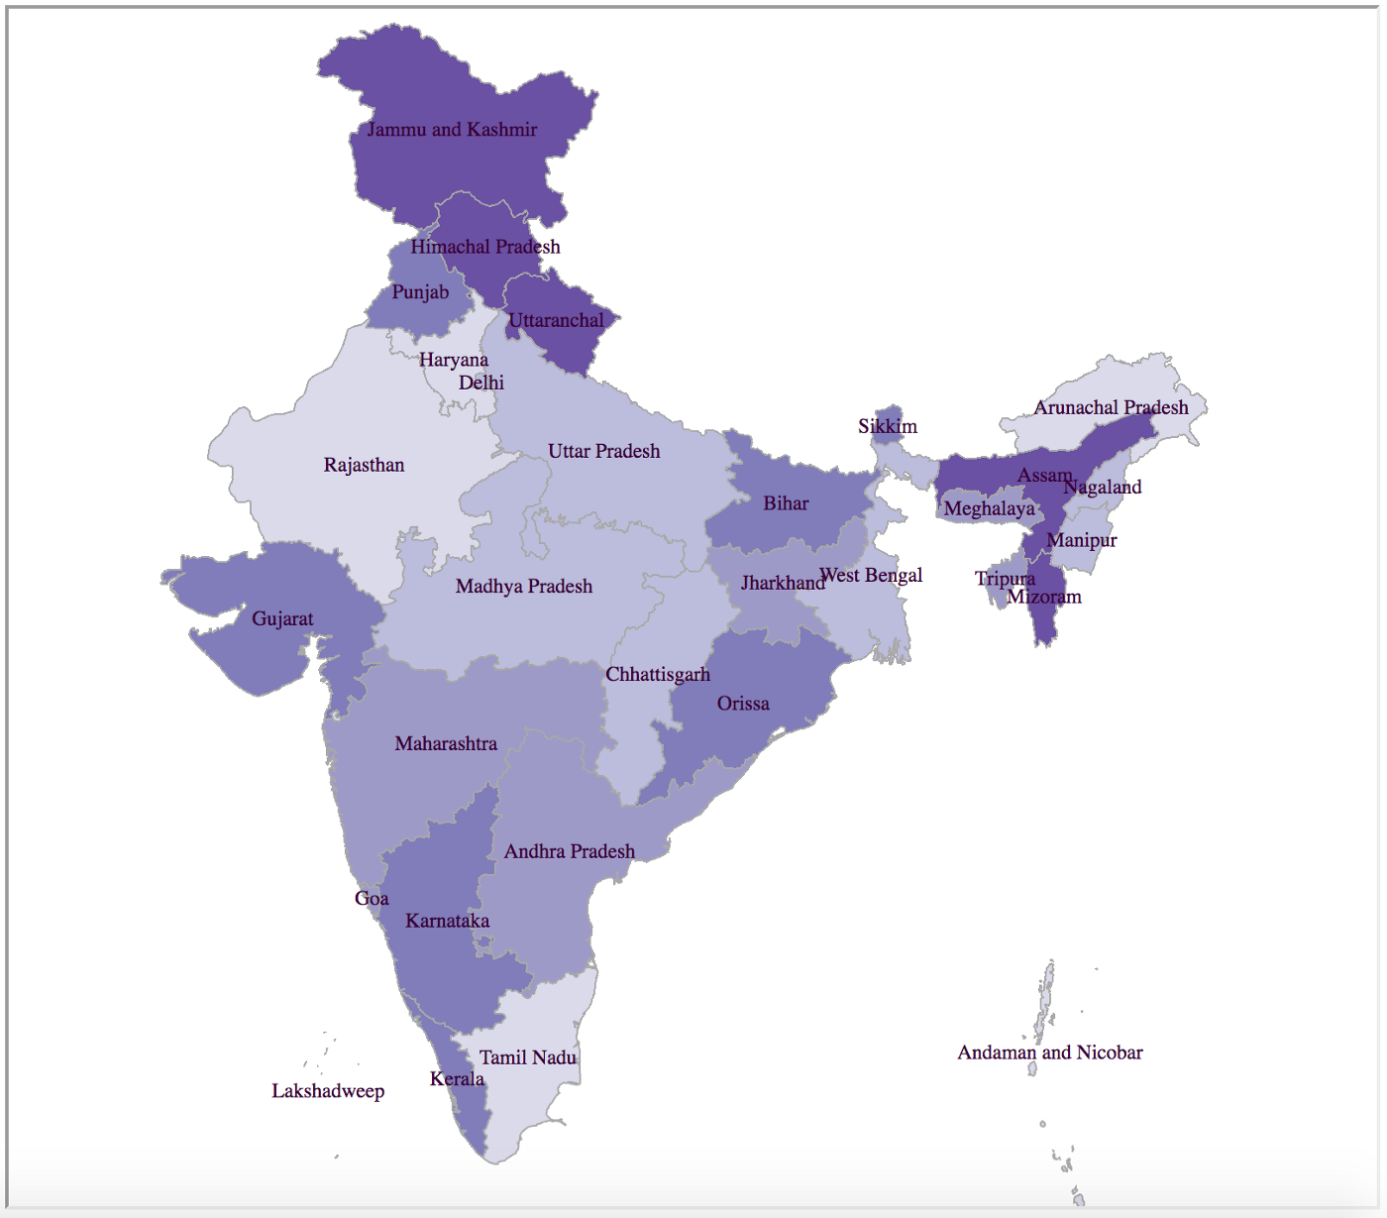
India map
CPS Lab, Institute of Informatics and Communication, UDSC

Slide 4
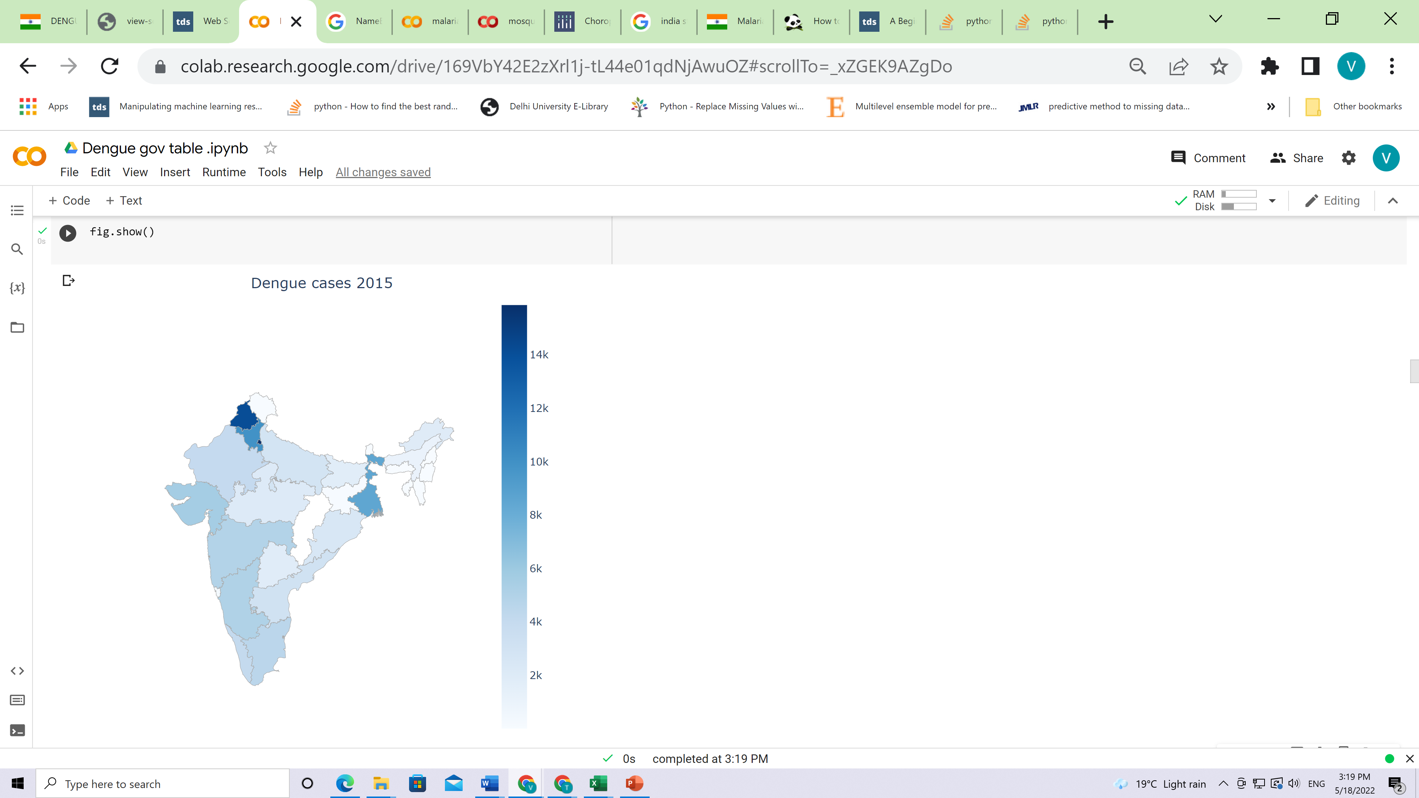
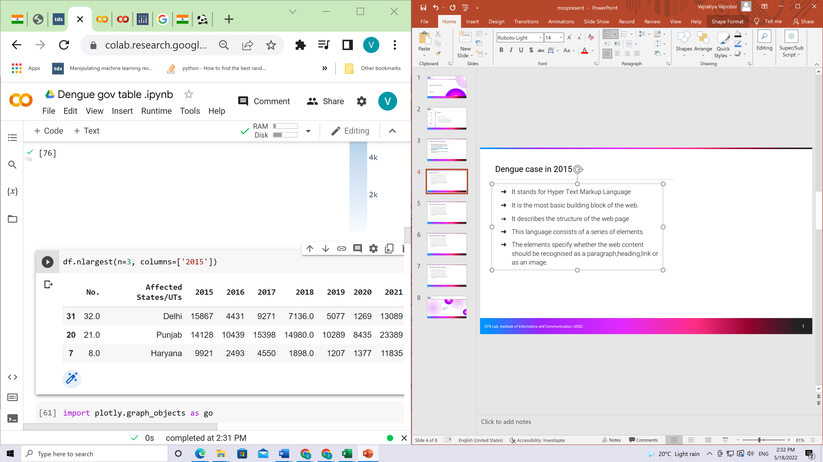
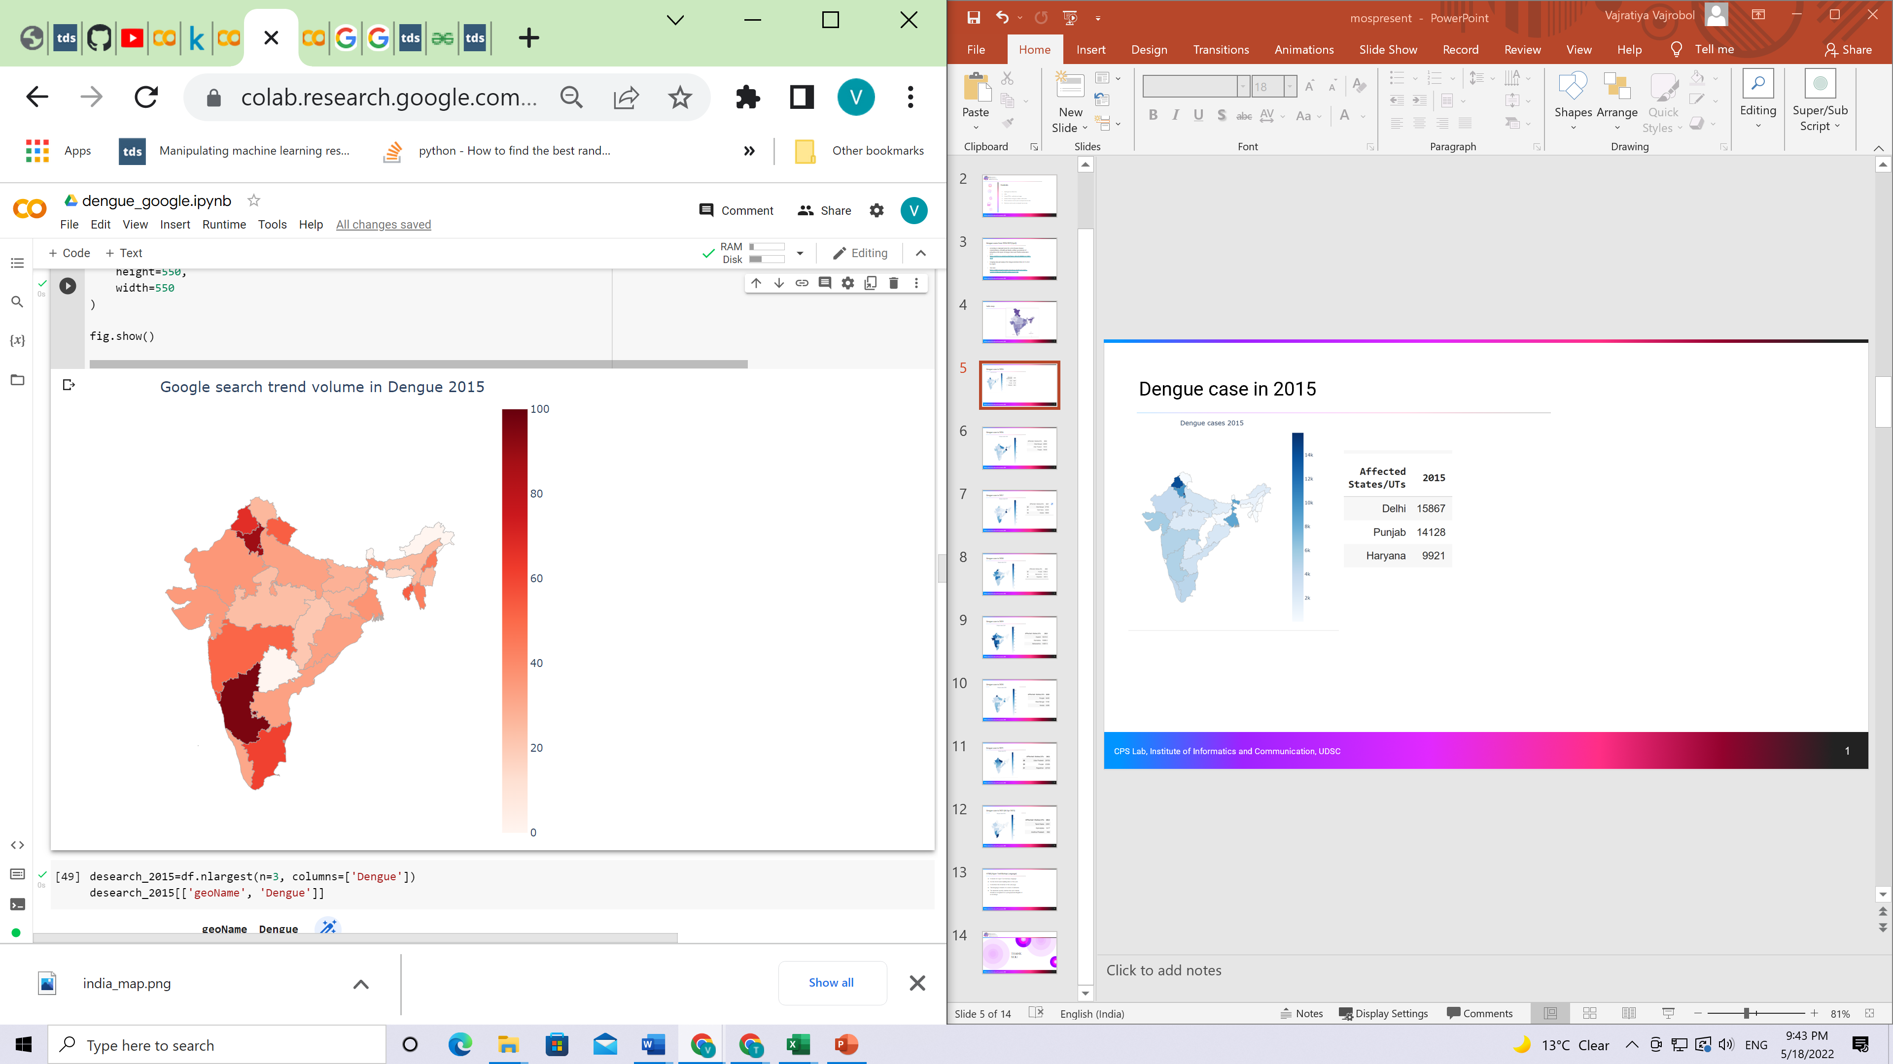
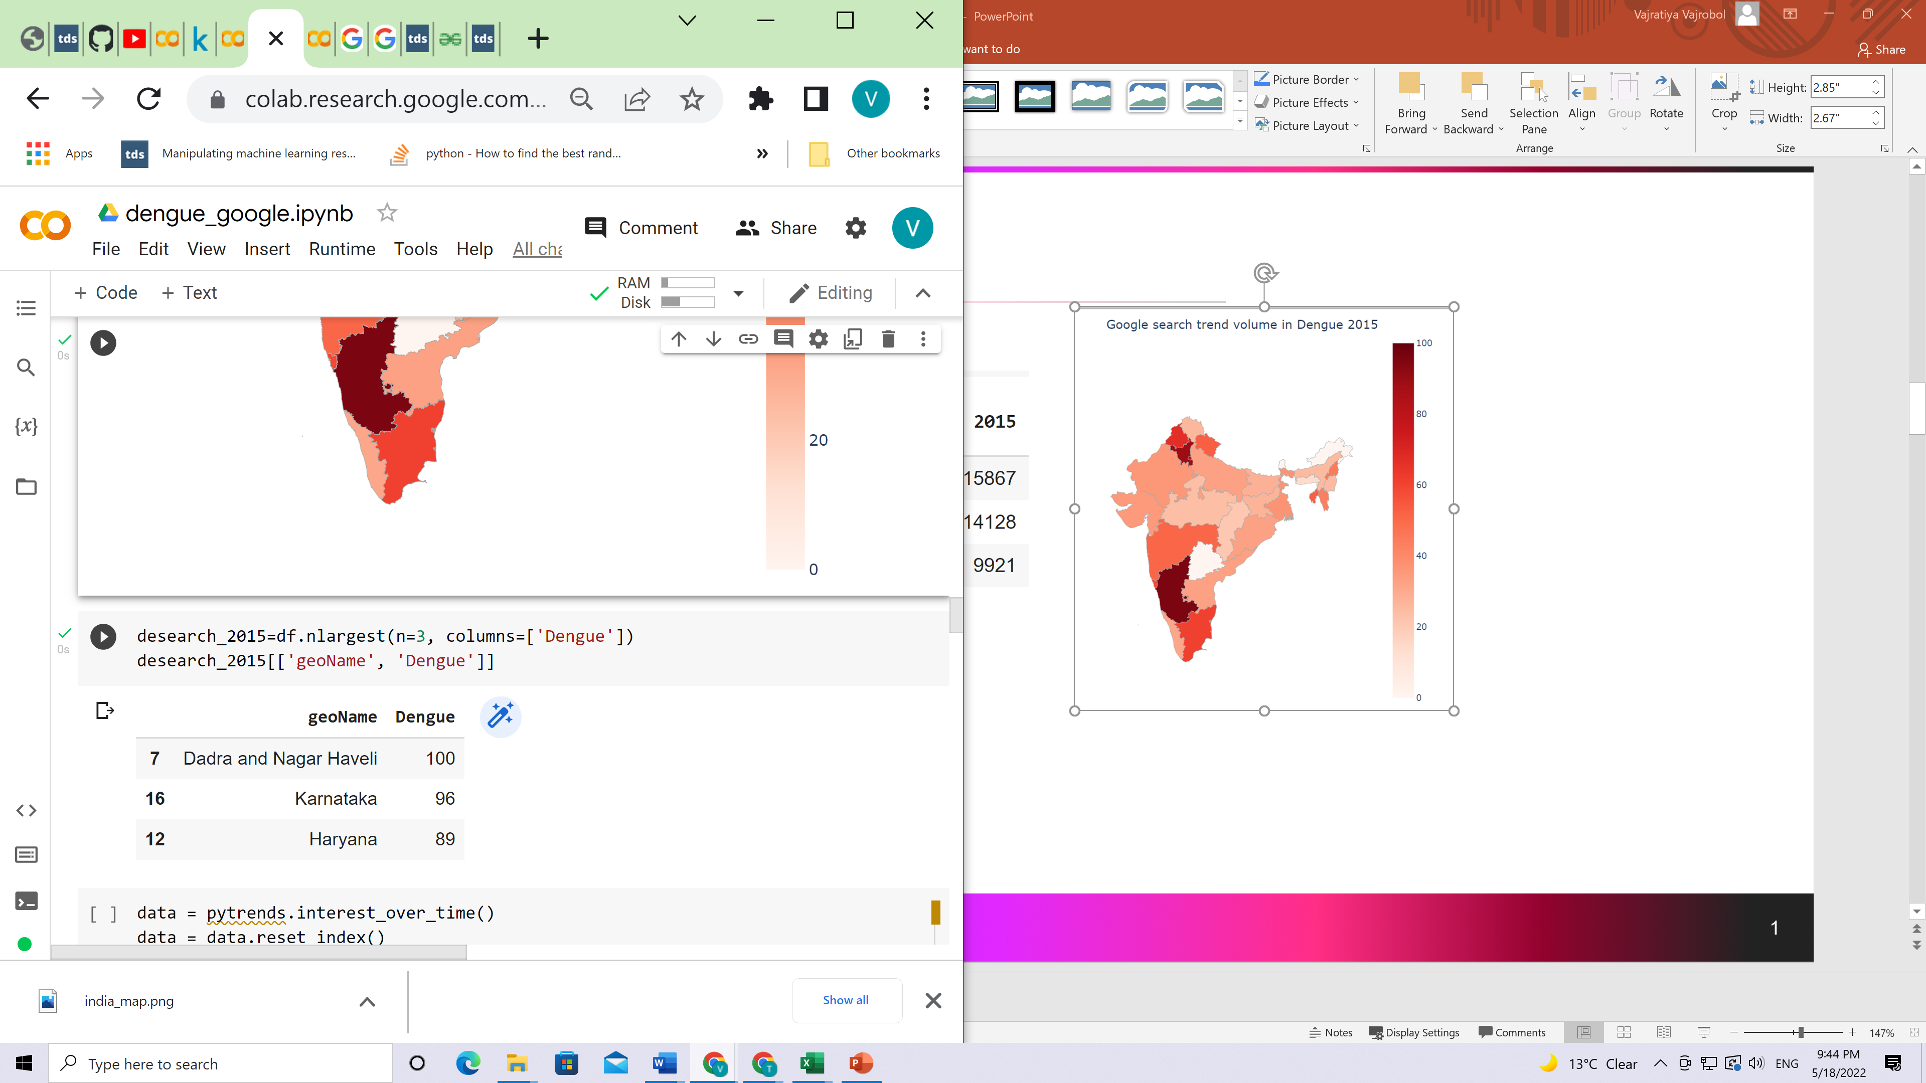
Dengue case in 2015
CPS Lab, Institute of Informatics and Communication, UDSC

Slide 5
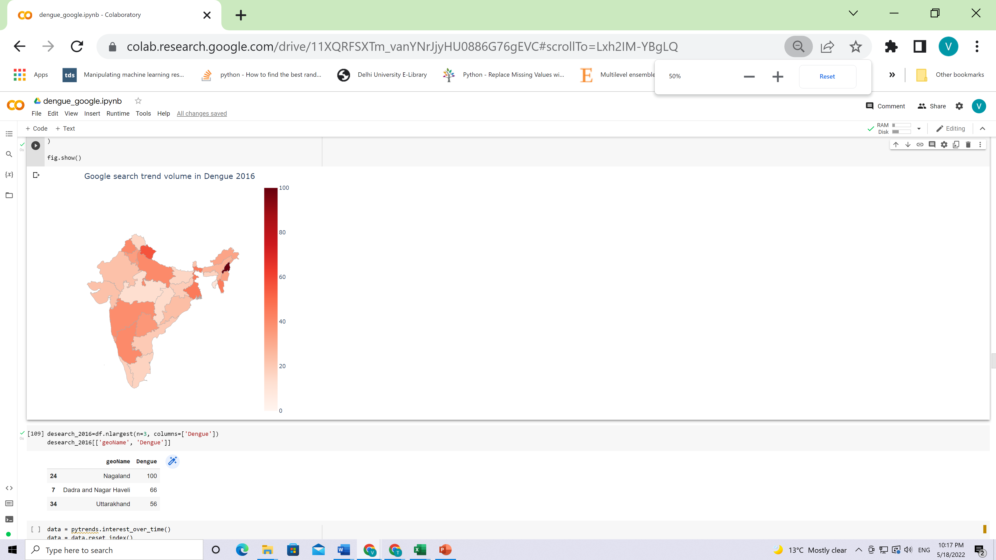
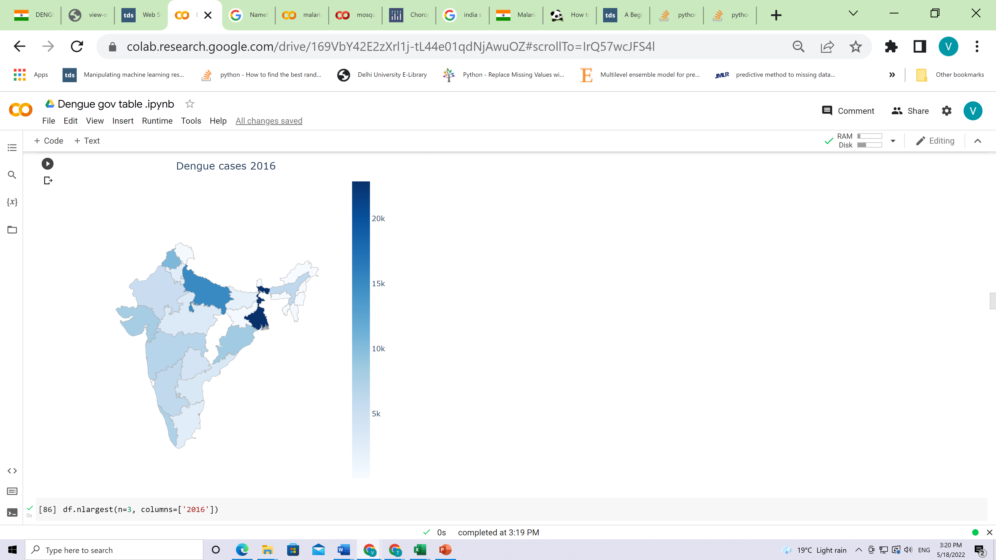
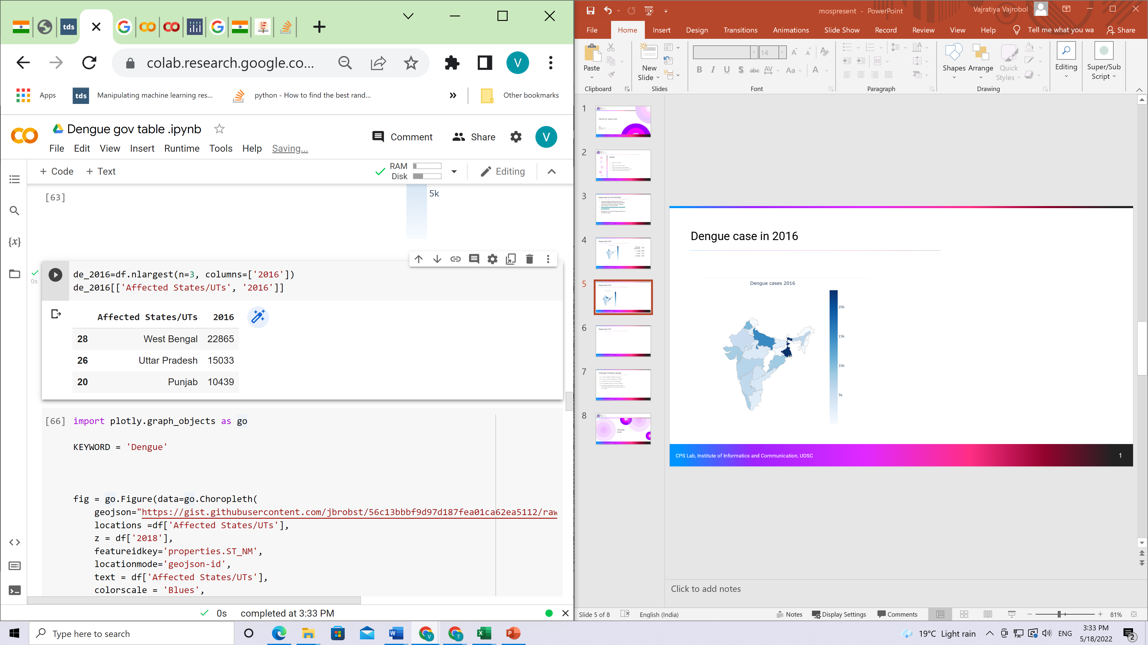
Dengue case in 2016
CPS Lab, Institute of Informatics and Communication, UDSC

Slide 6
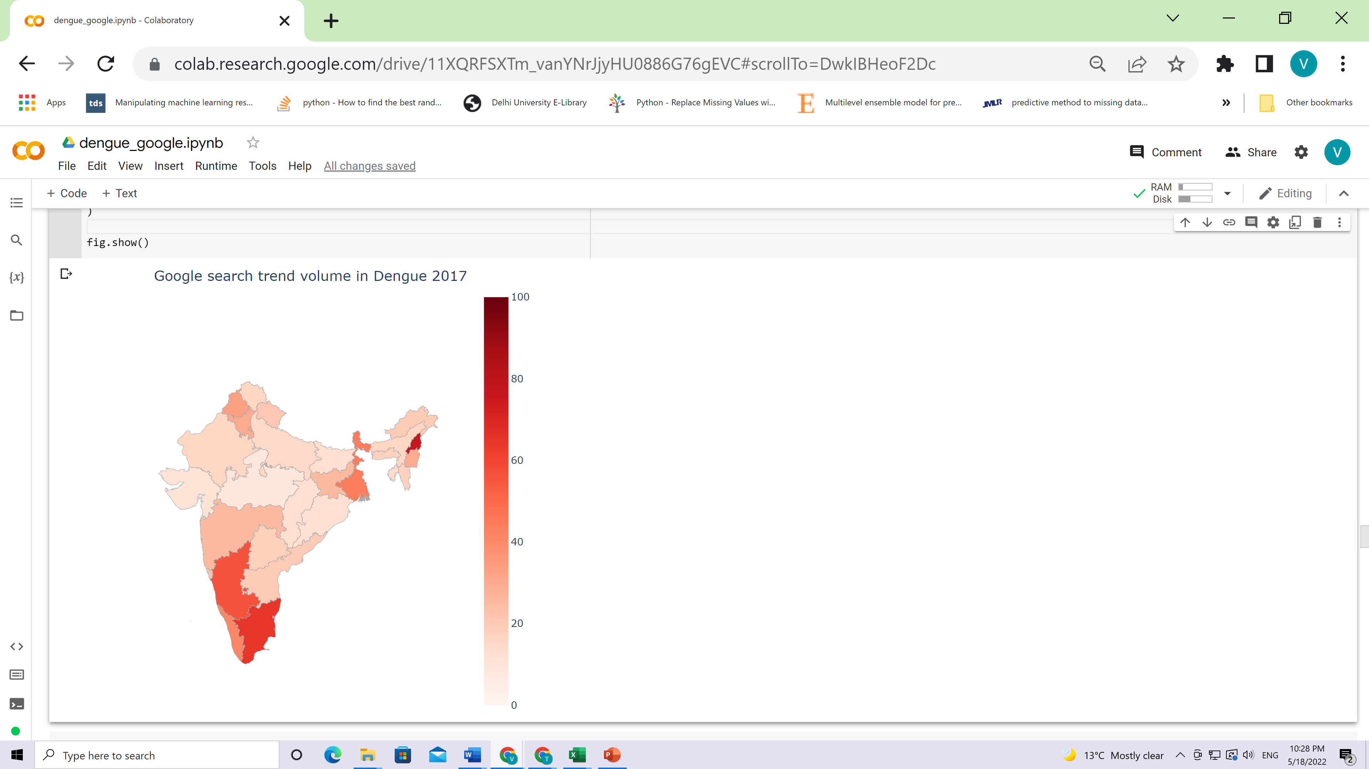
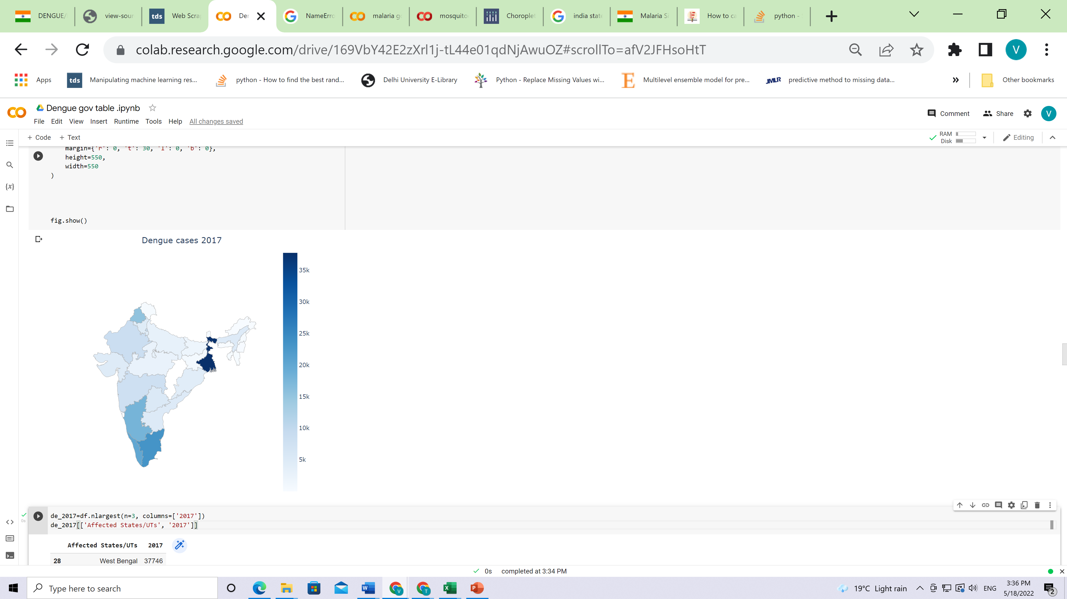
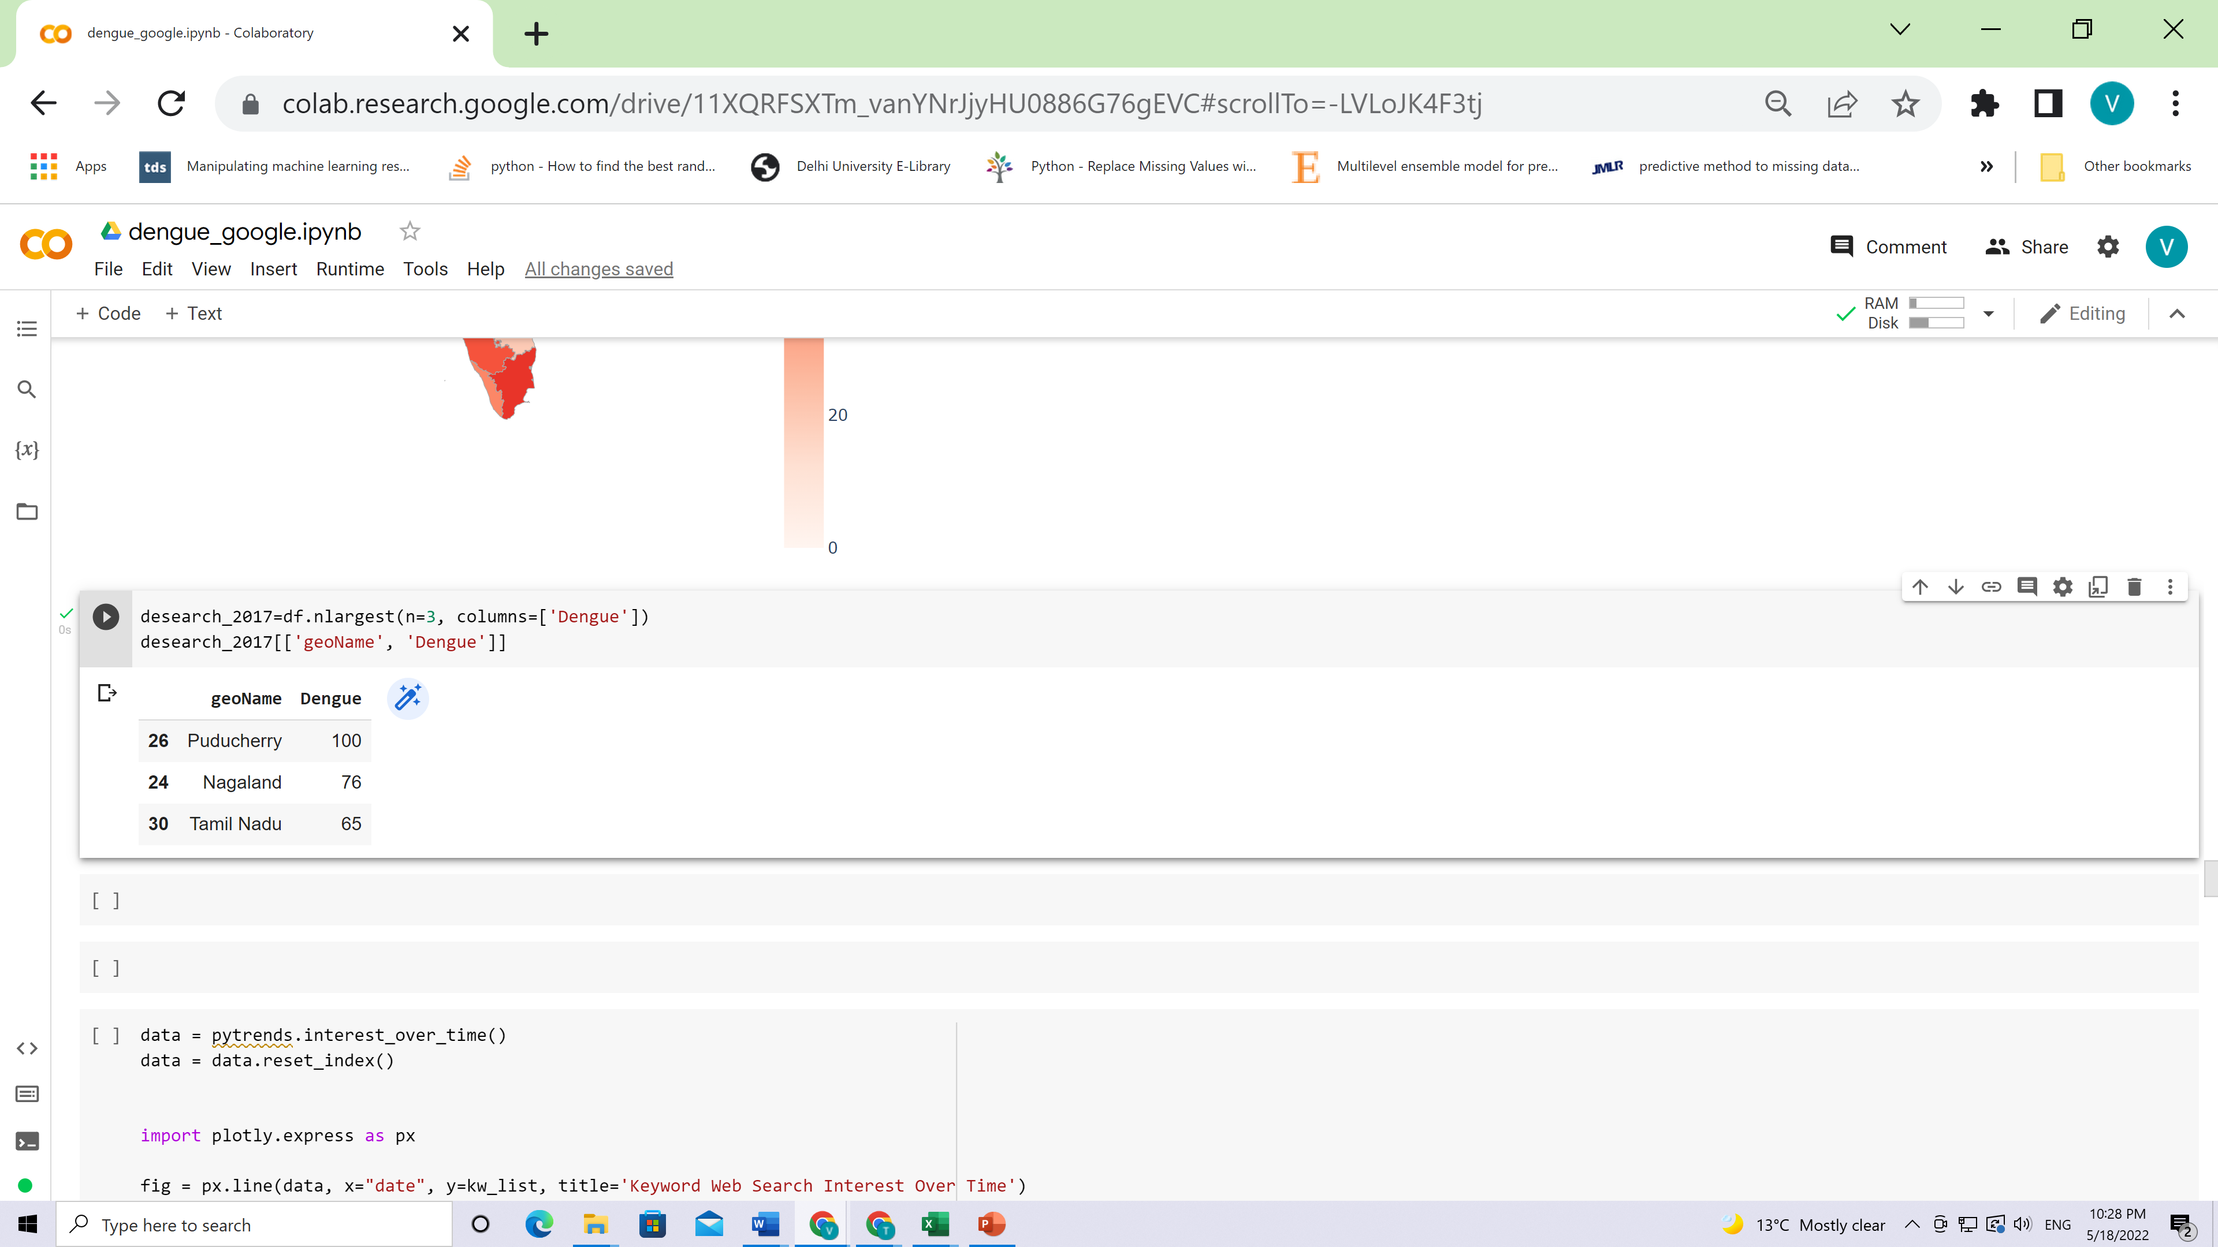
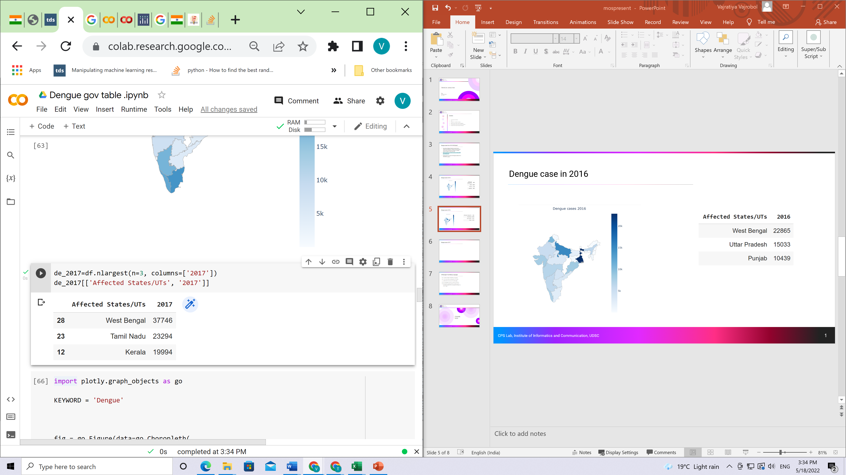

Dengue case in 2017
CPS Lab, Institute of Informatics and Communication, UDSC

Slide 7
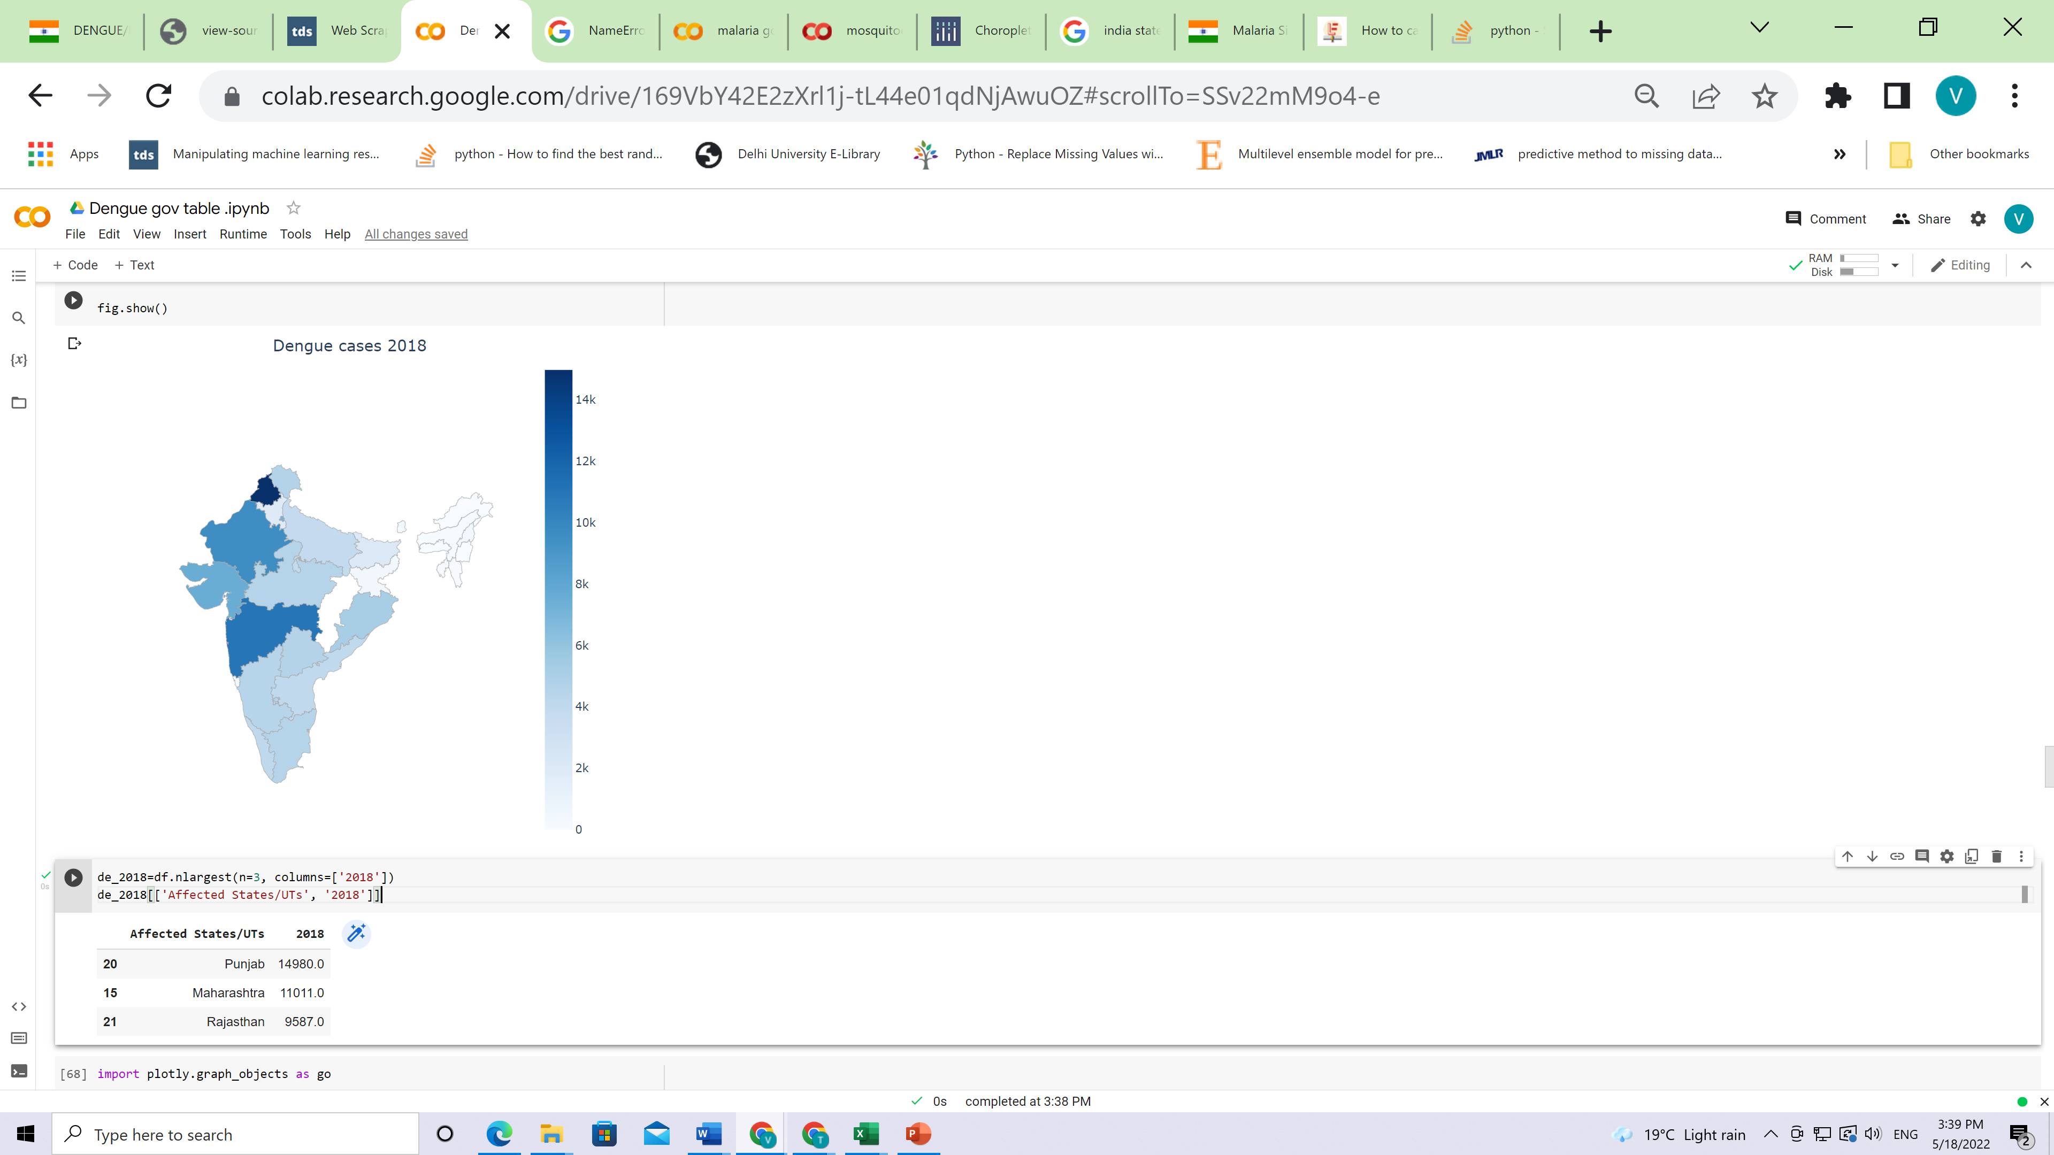
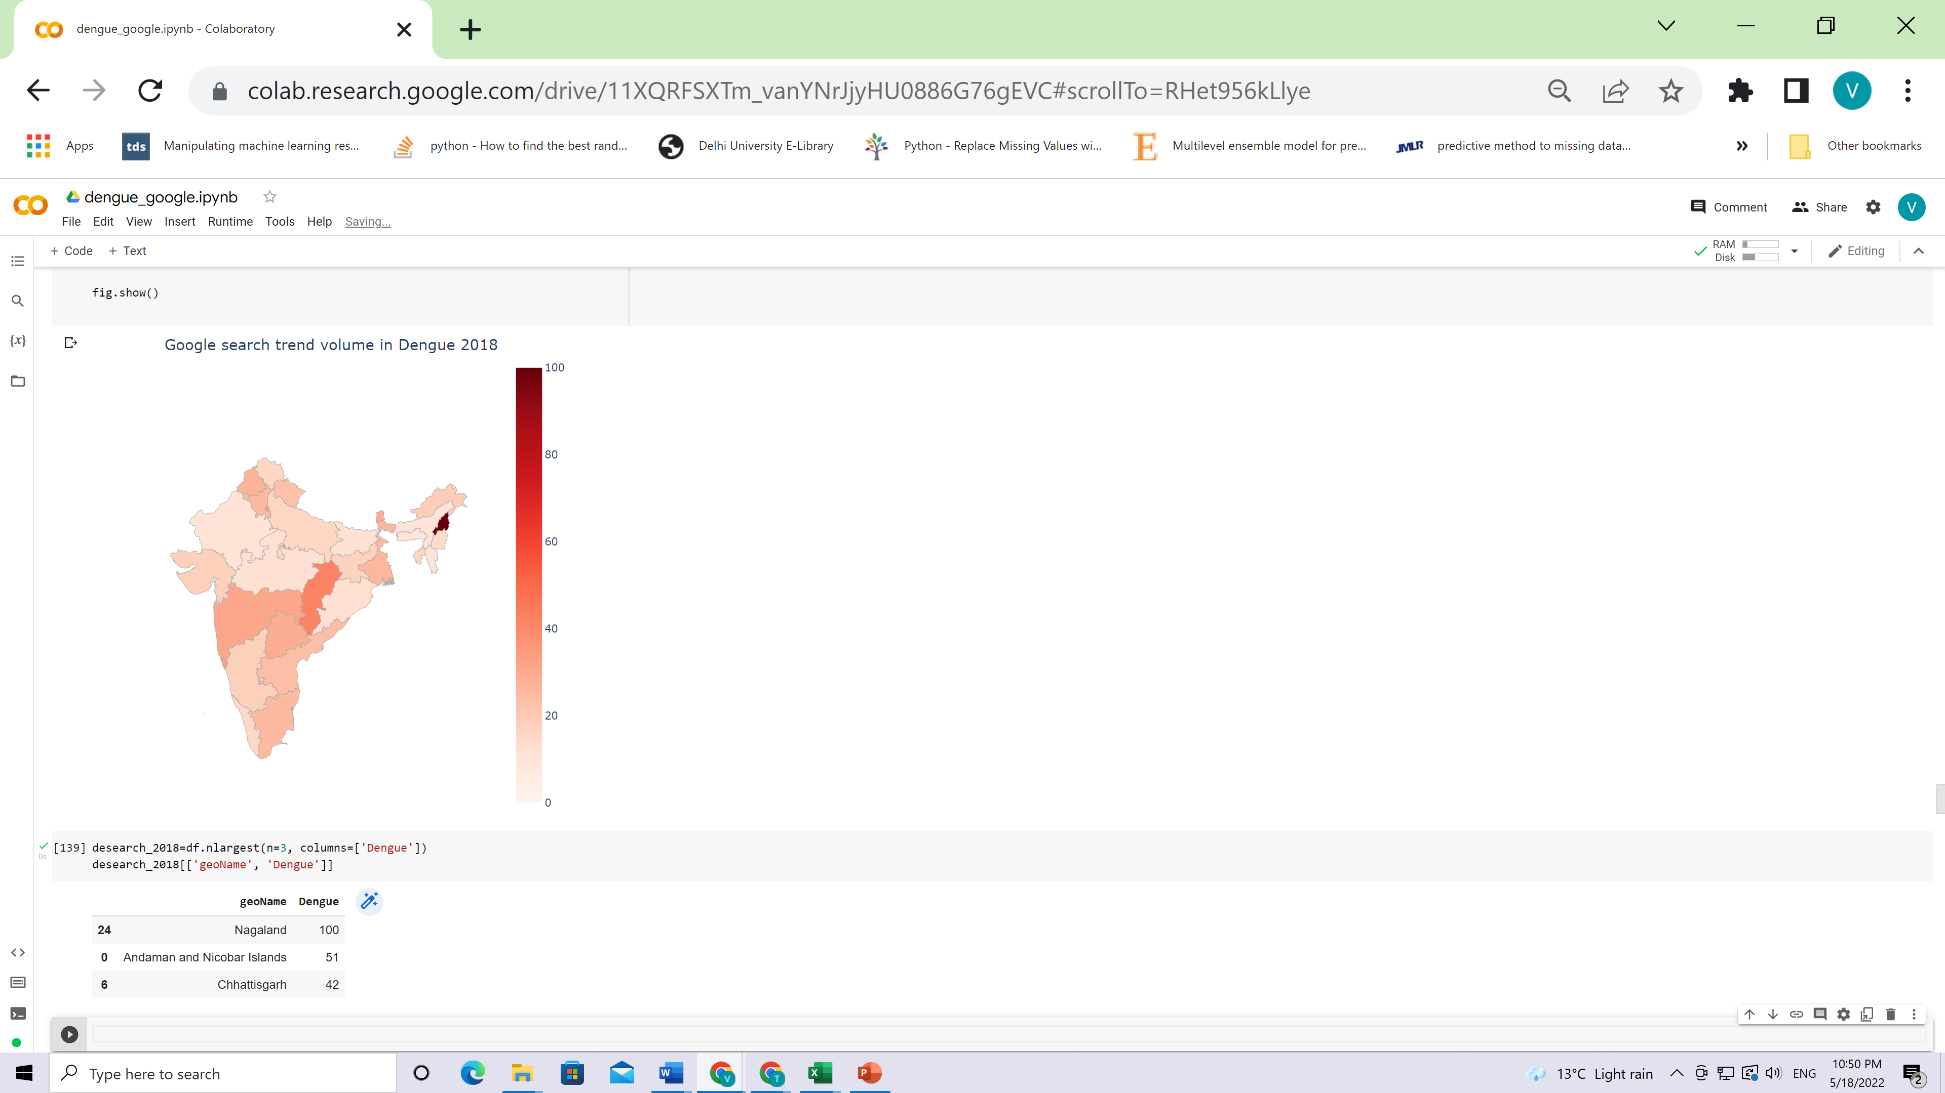
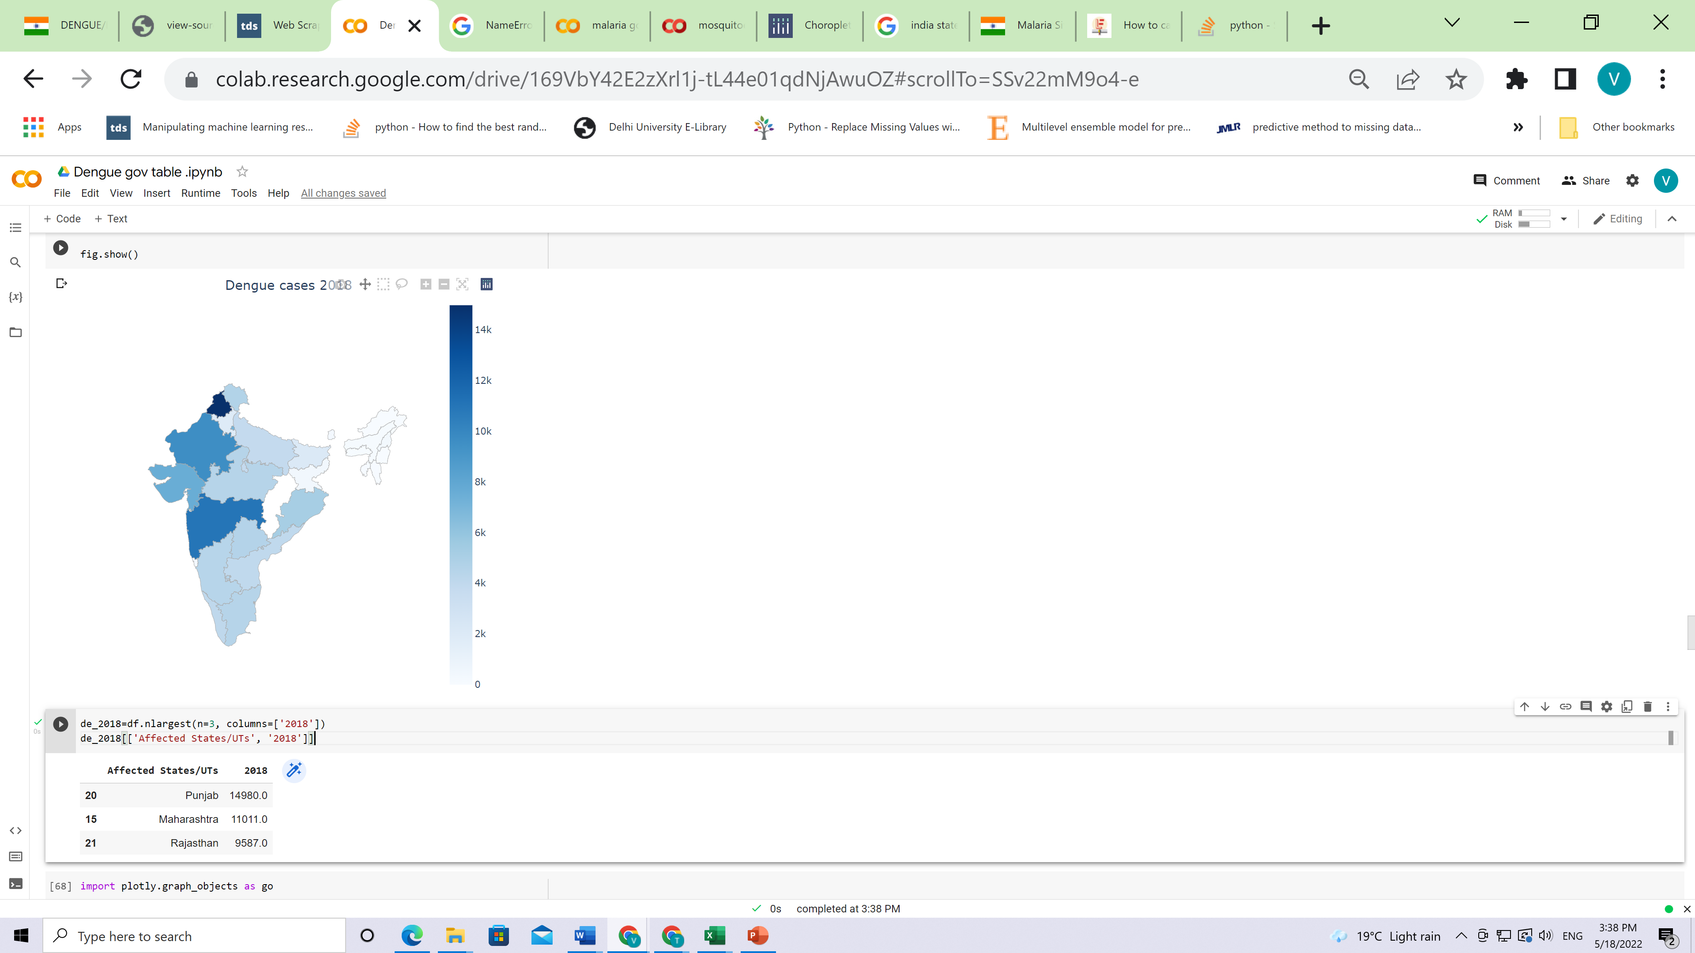
Dengue case in 2018
CPS Lab, Institute of Informatics and Communication, UDSC

Slide 8
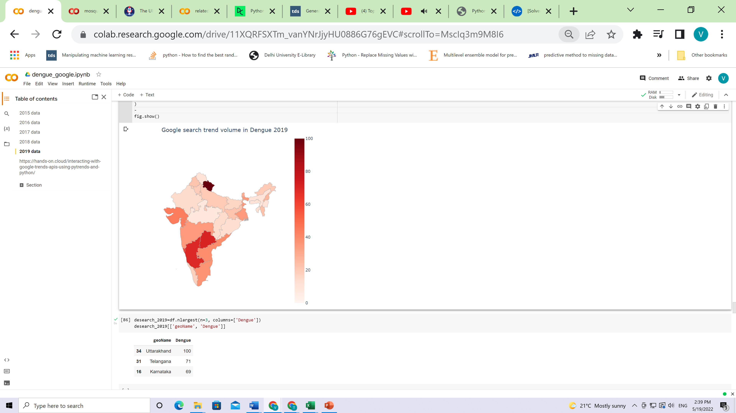
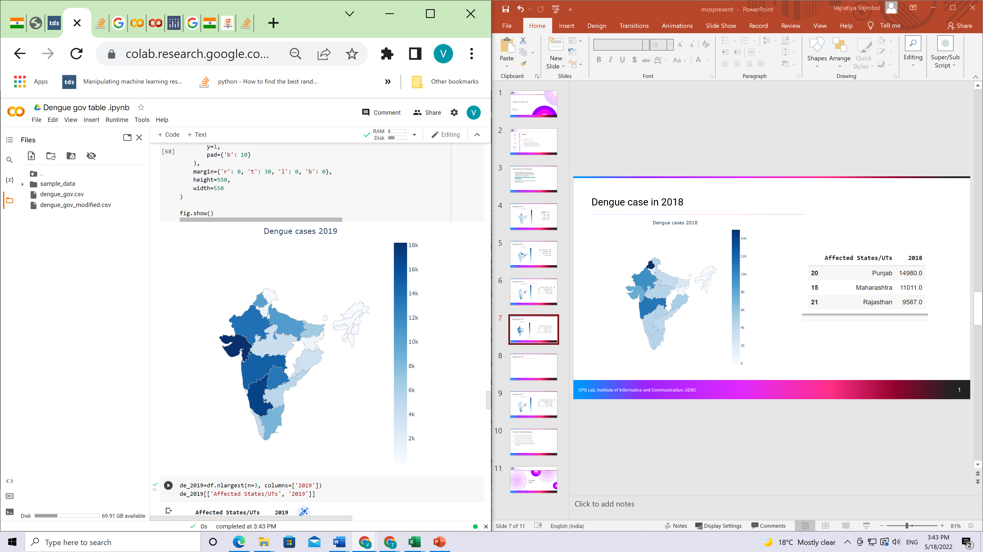
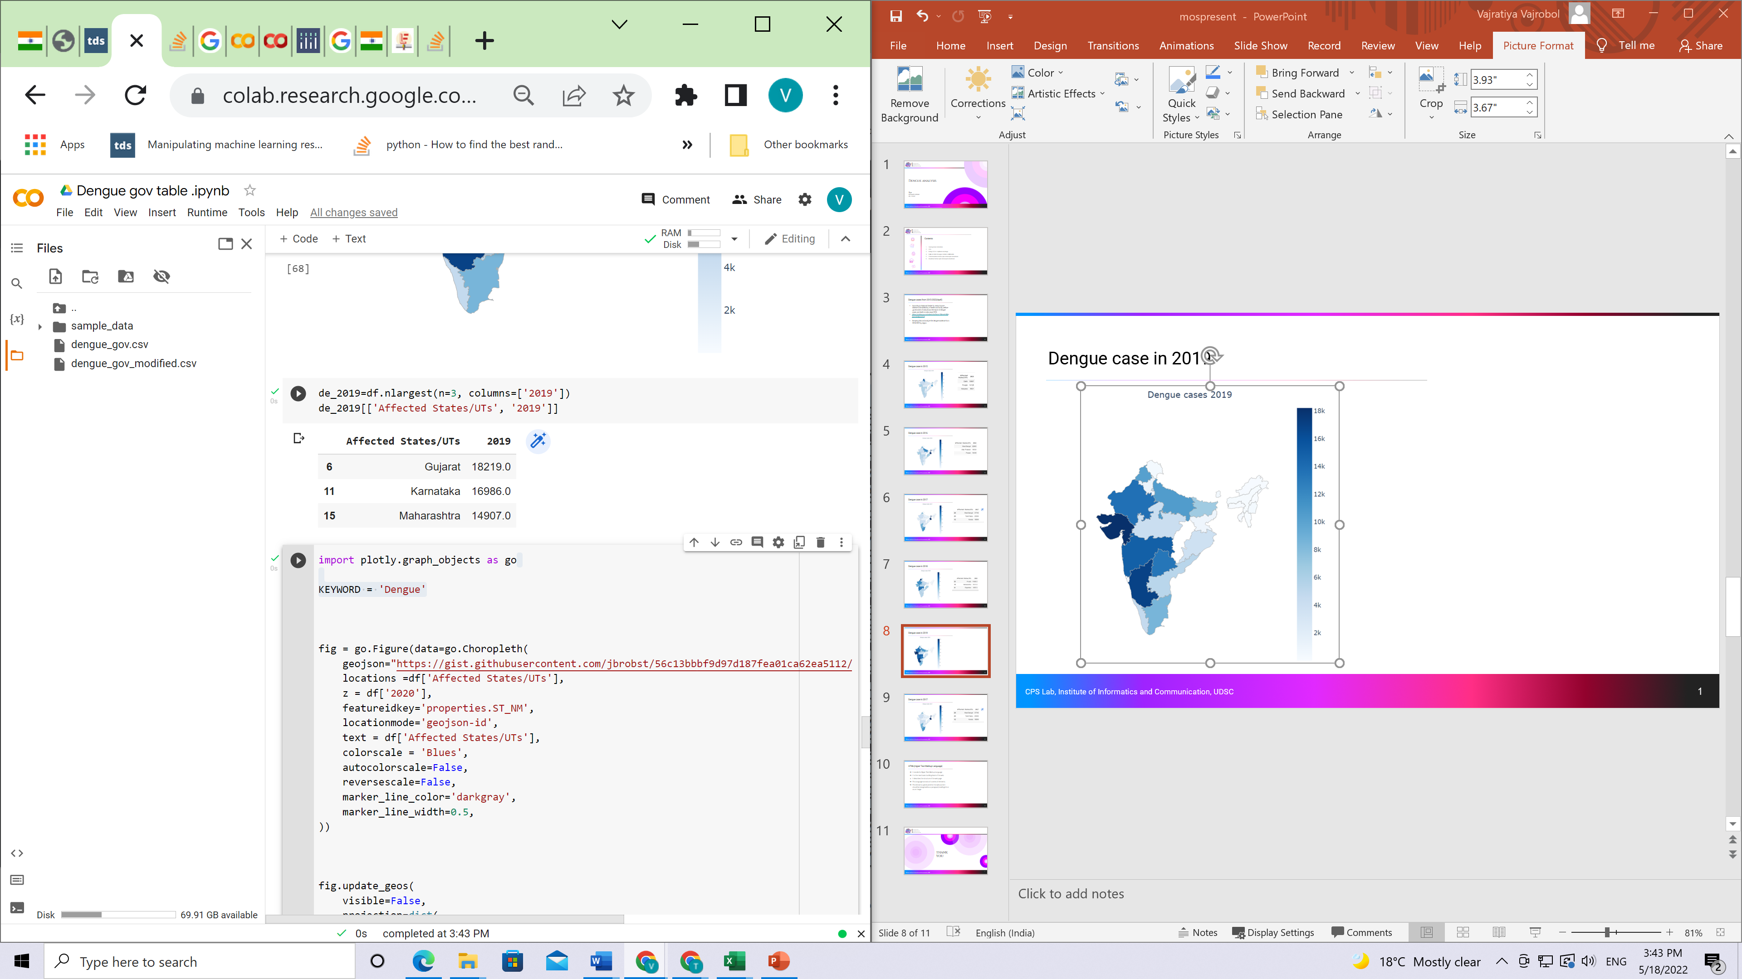
Dengue case in 2019
CPS Lab, Institute of Informatics and Communication, UDSC

Slide 9
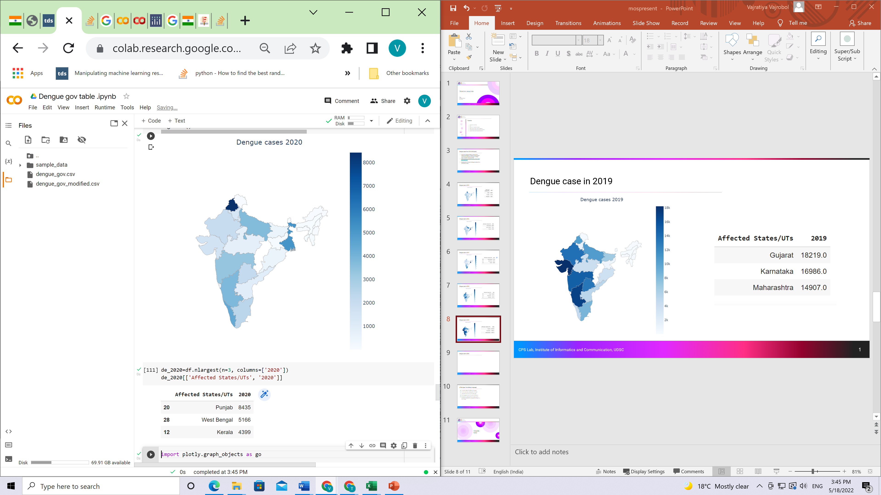
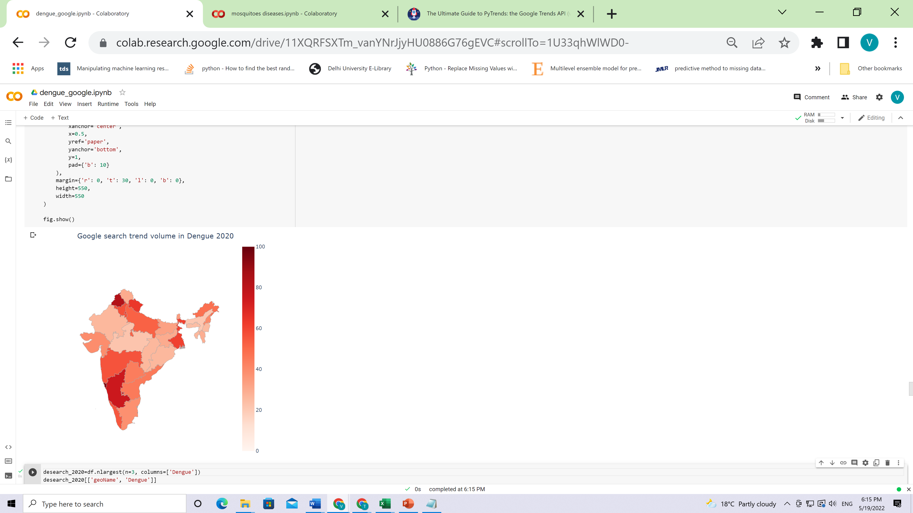
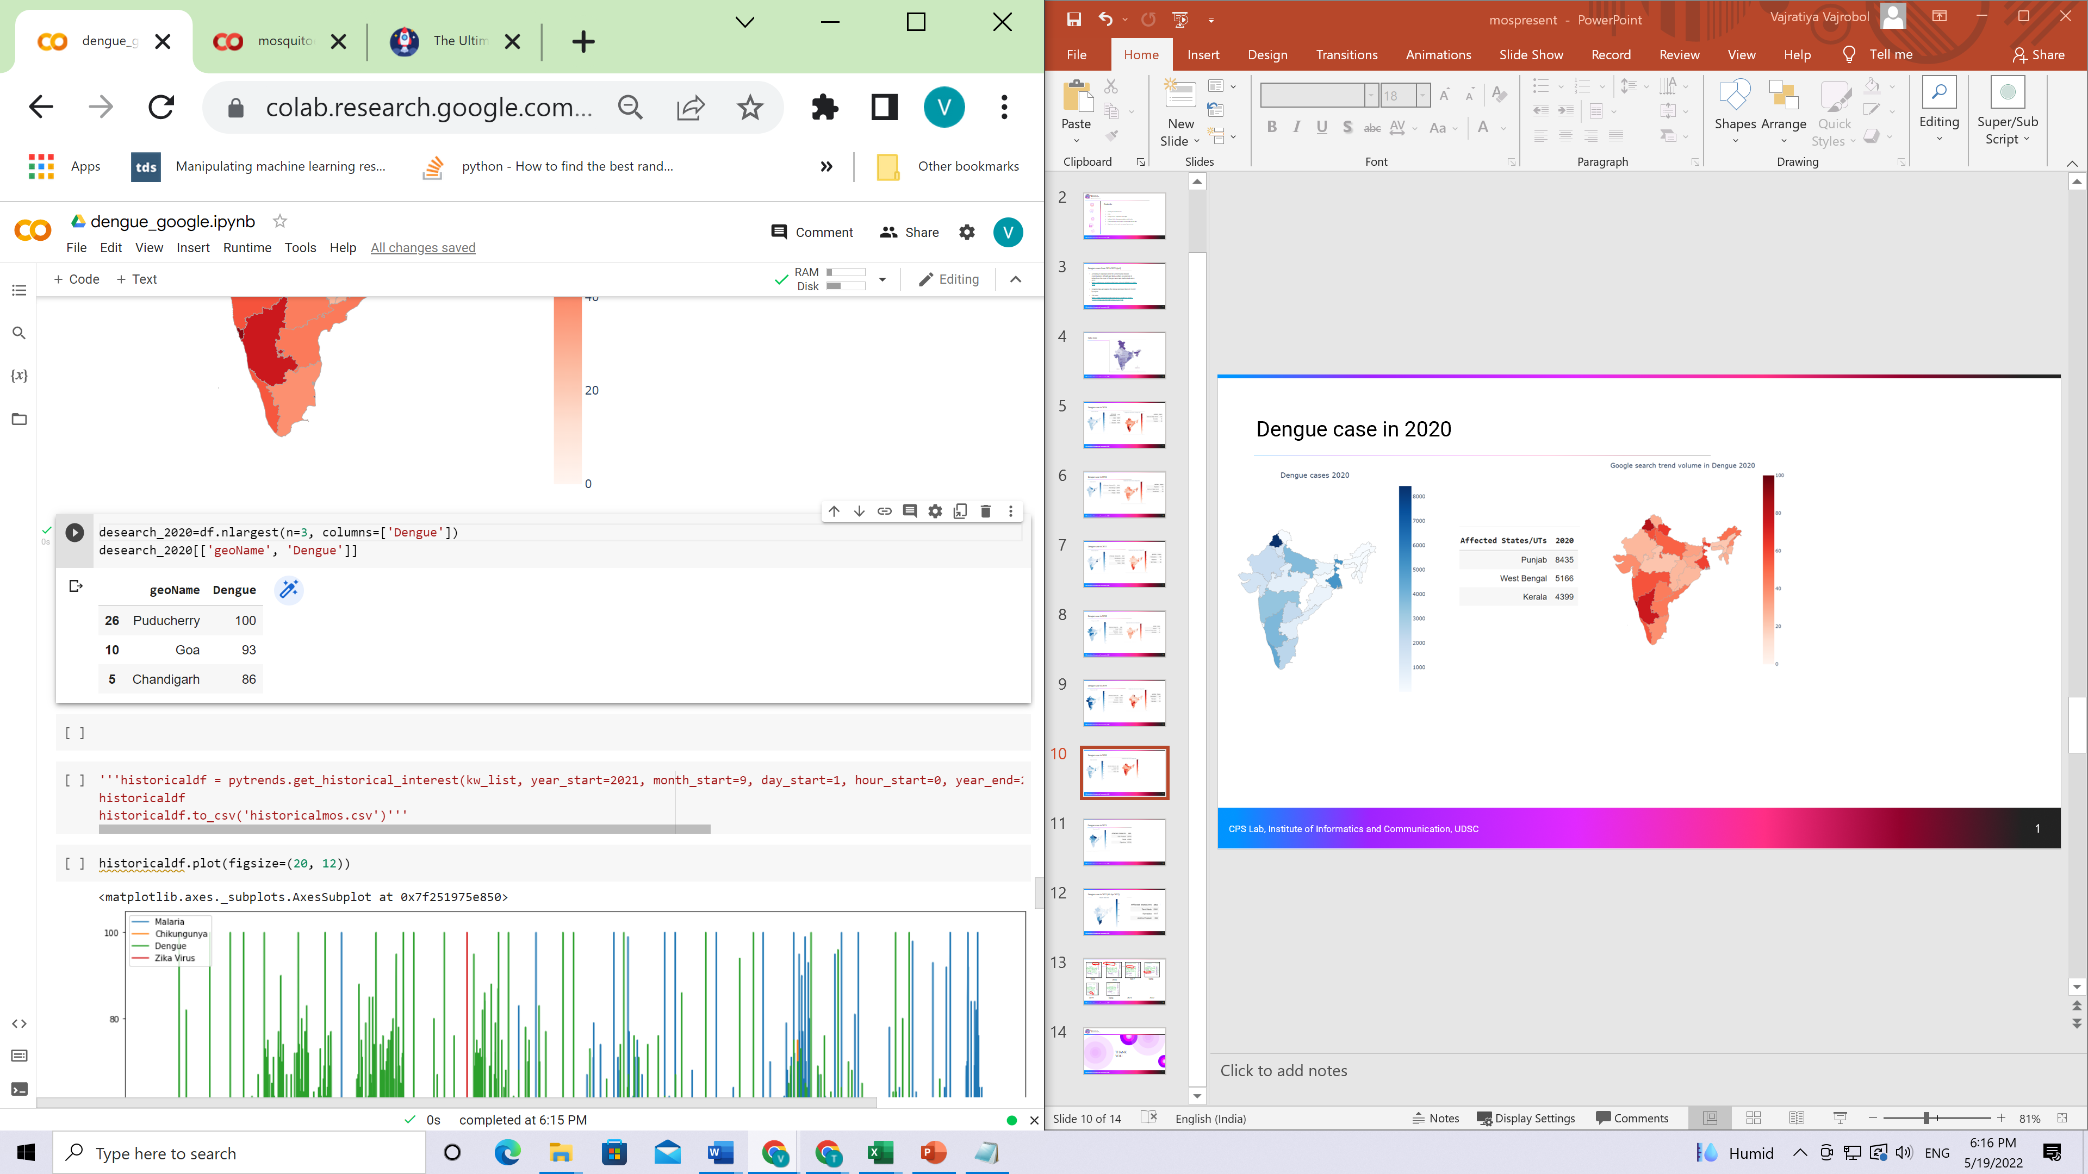

Dengue case in 2020
CPS Lab, Institute of Informatics and Communication, UDSC

Slide 10
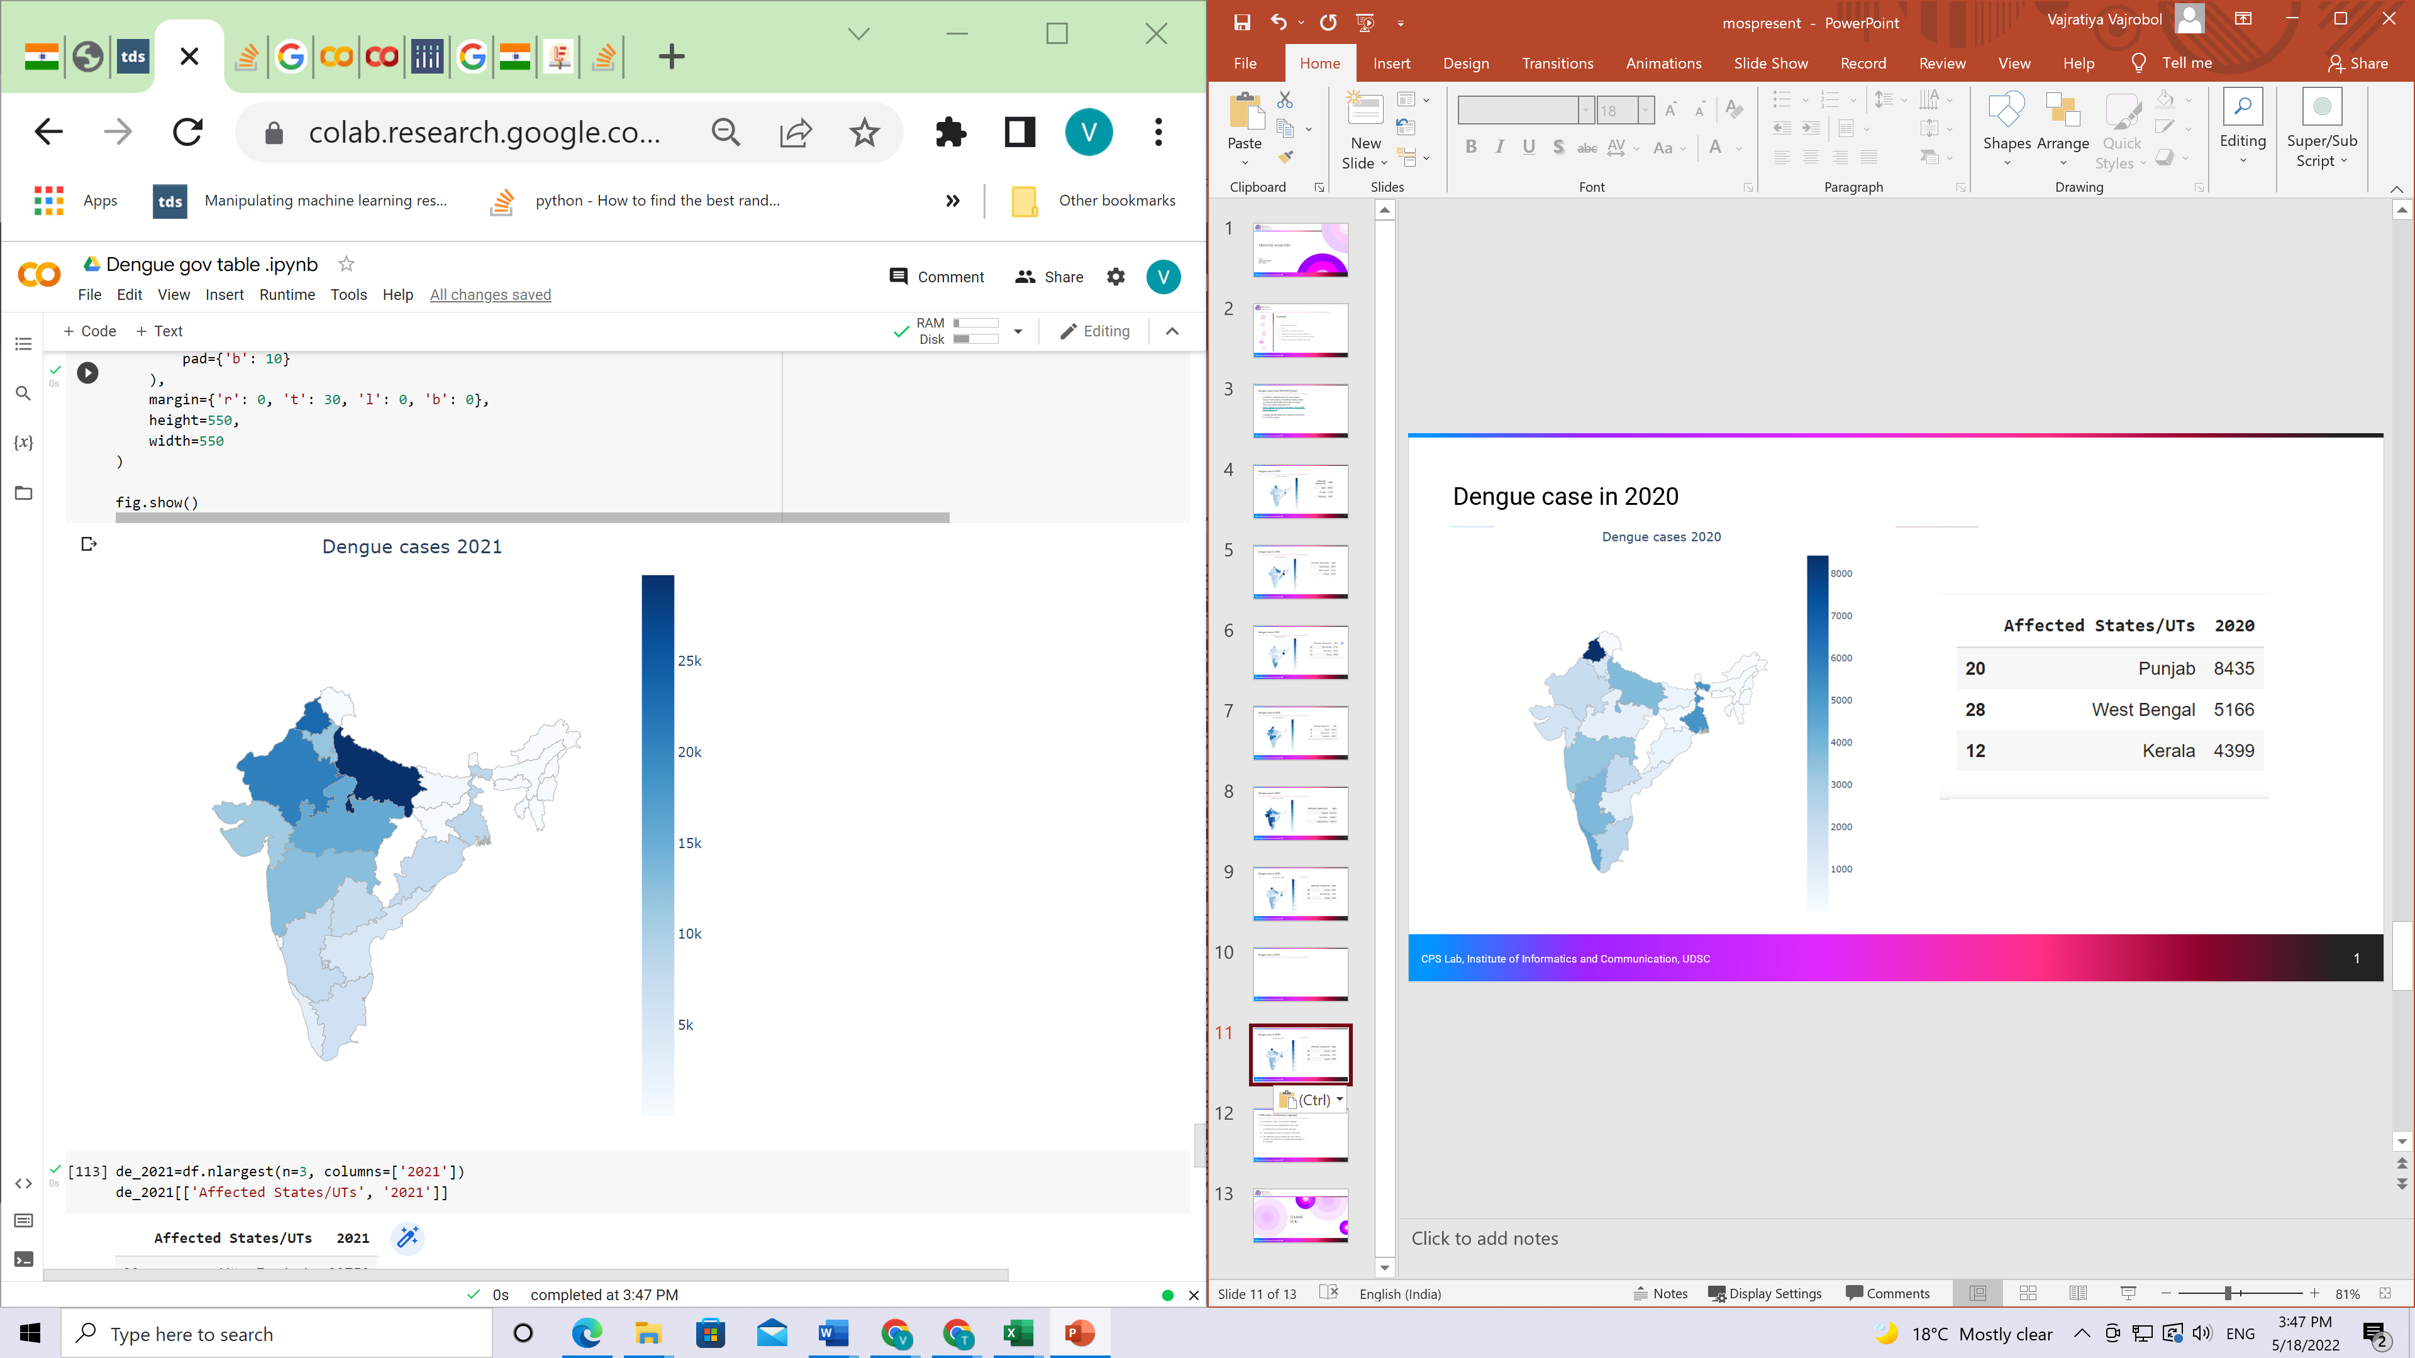
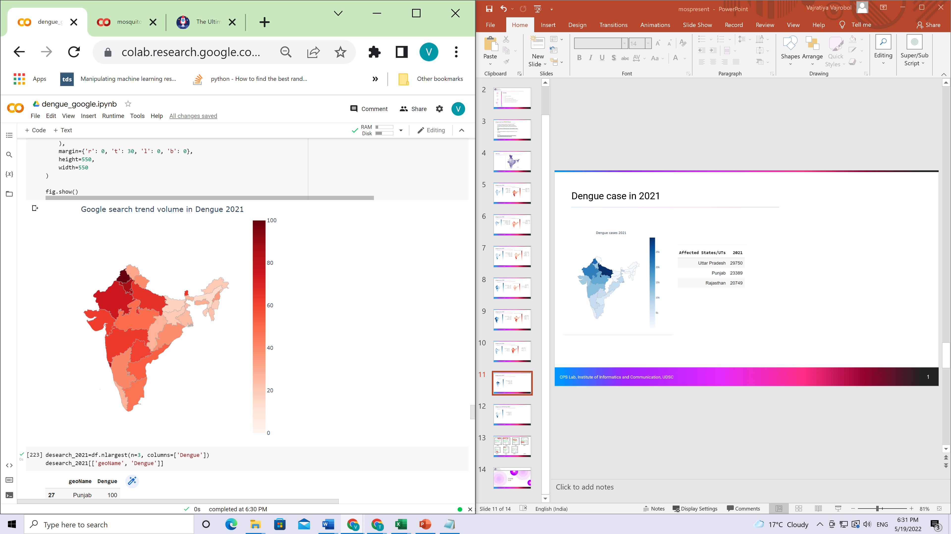
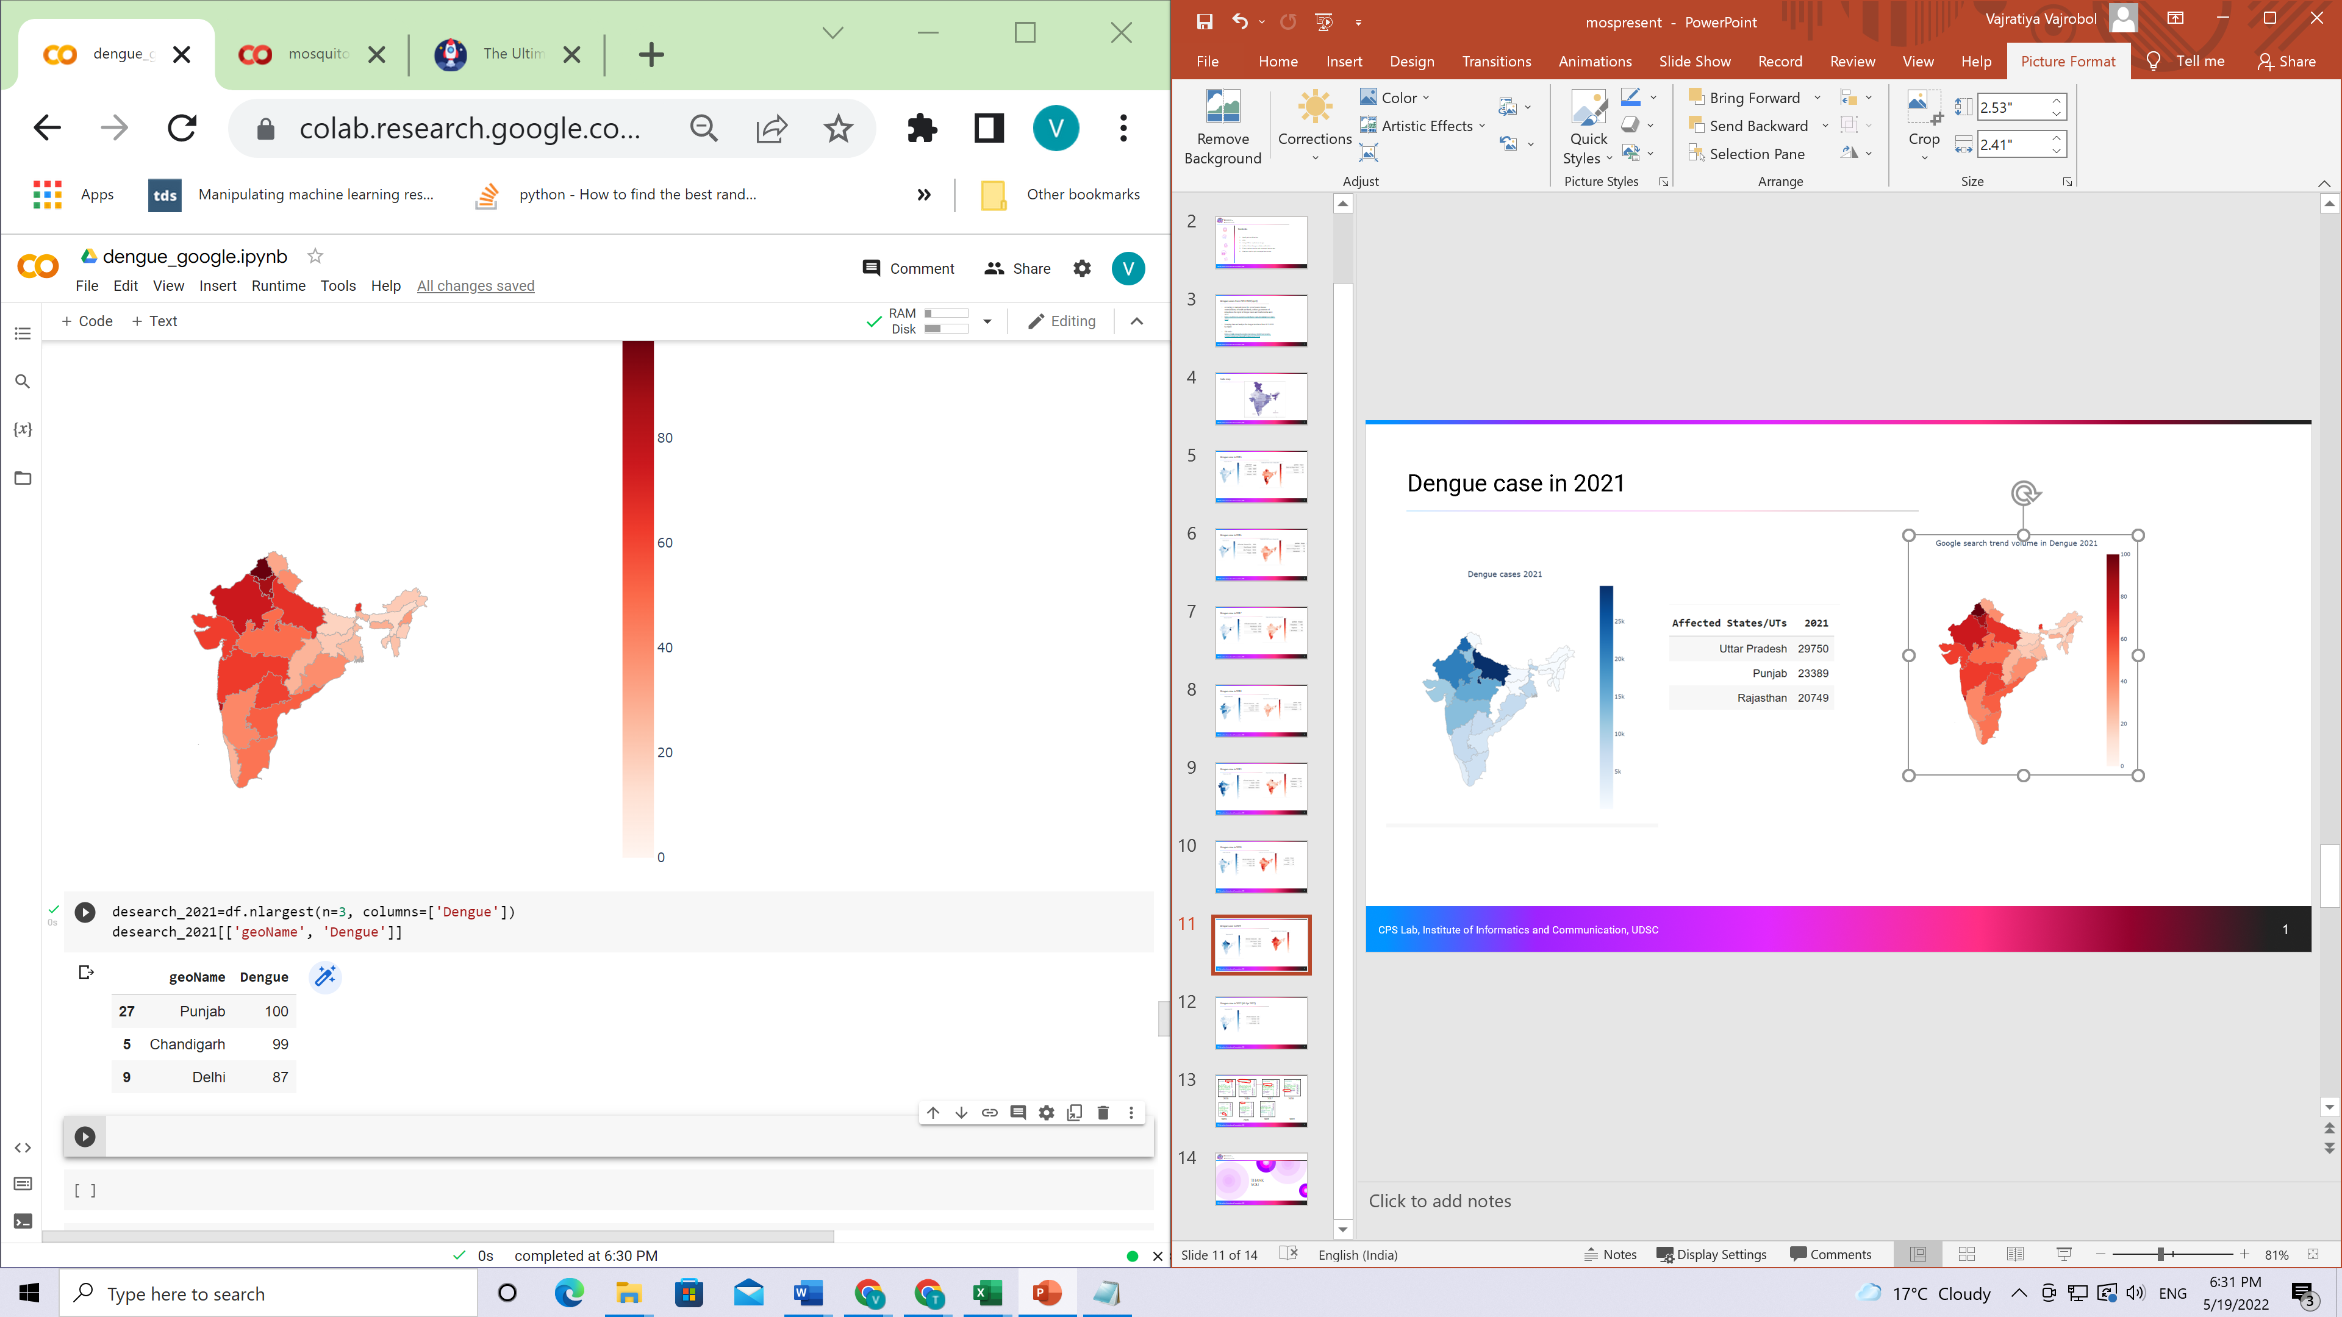
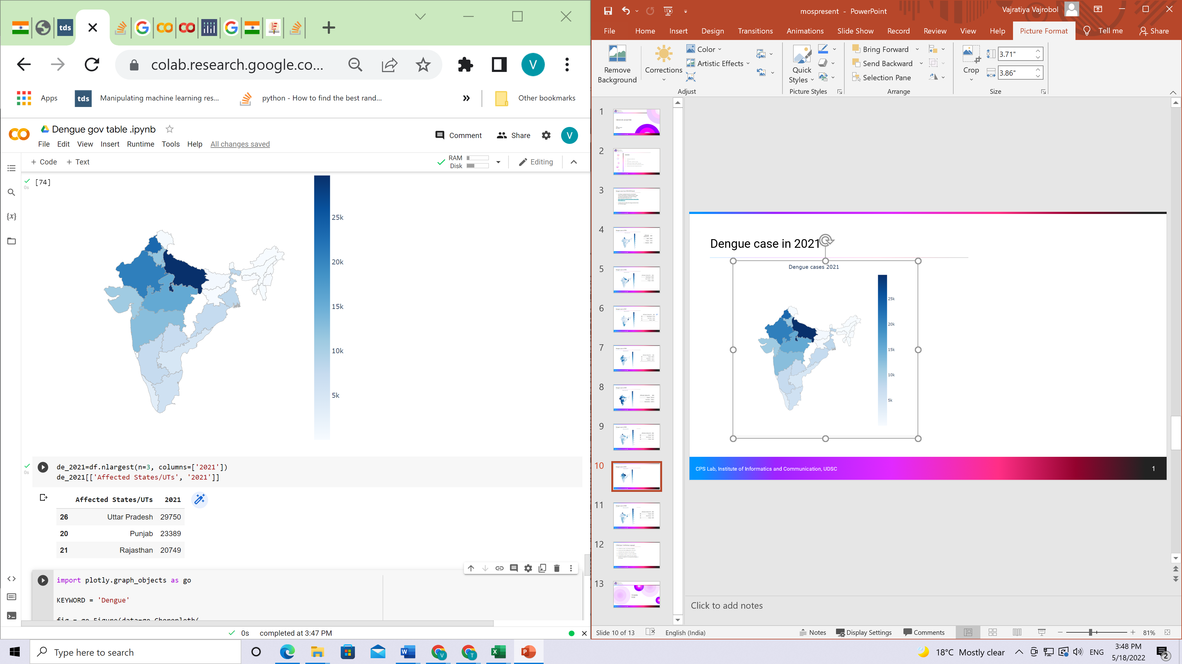
Dengue case in 2021
CPS Lab, Institute of Informatics and Communication, UDSC

Slide 11
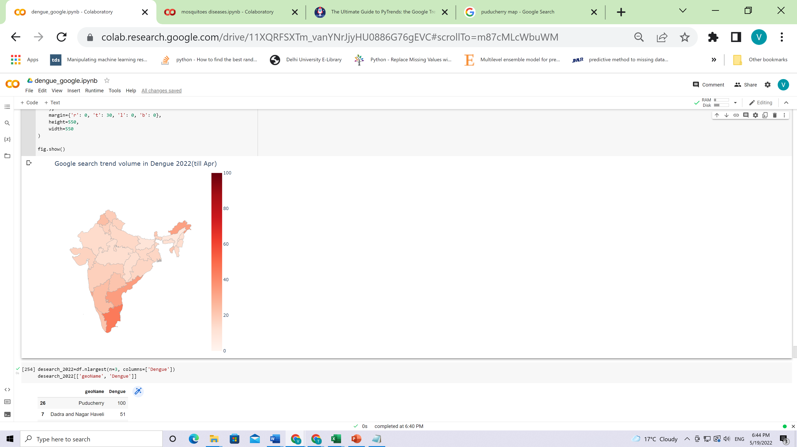
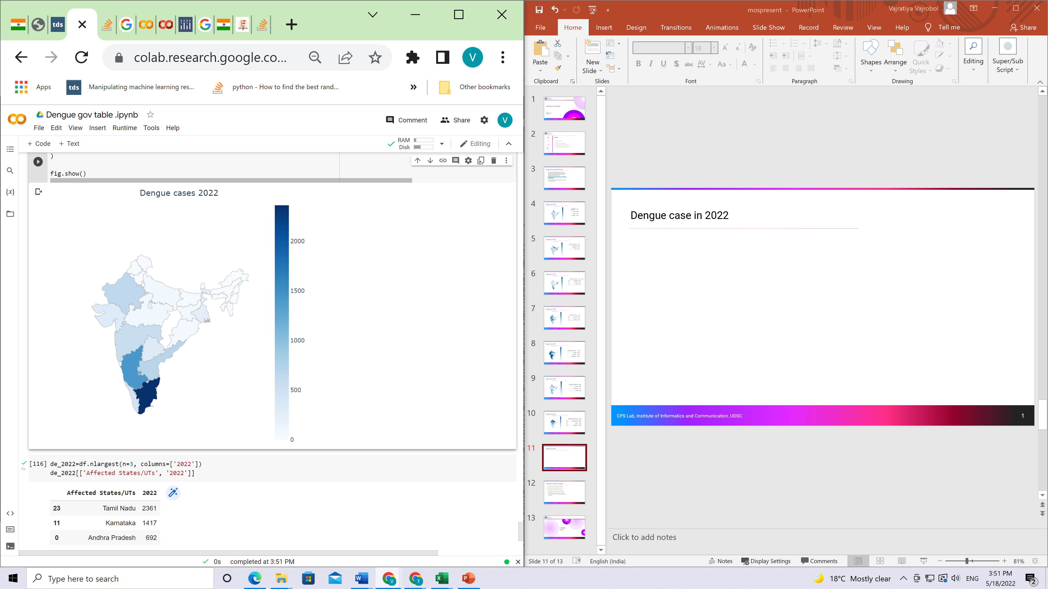
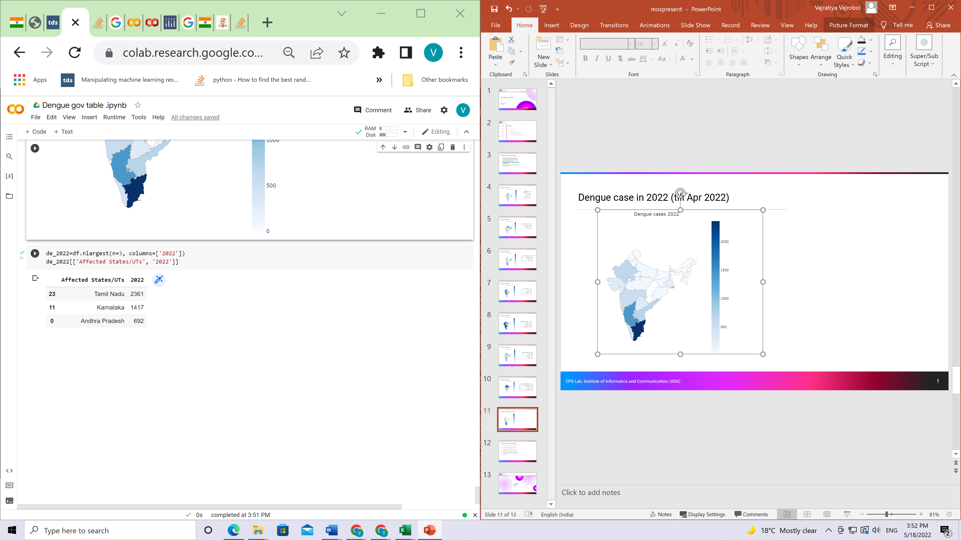
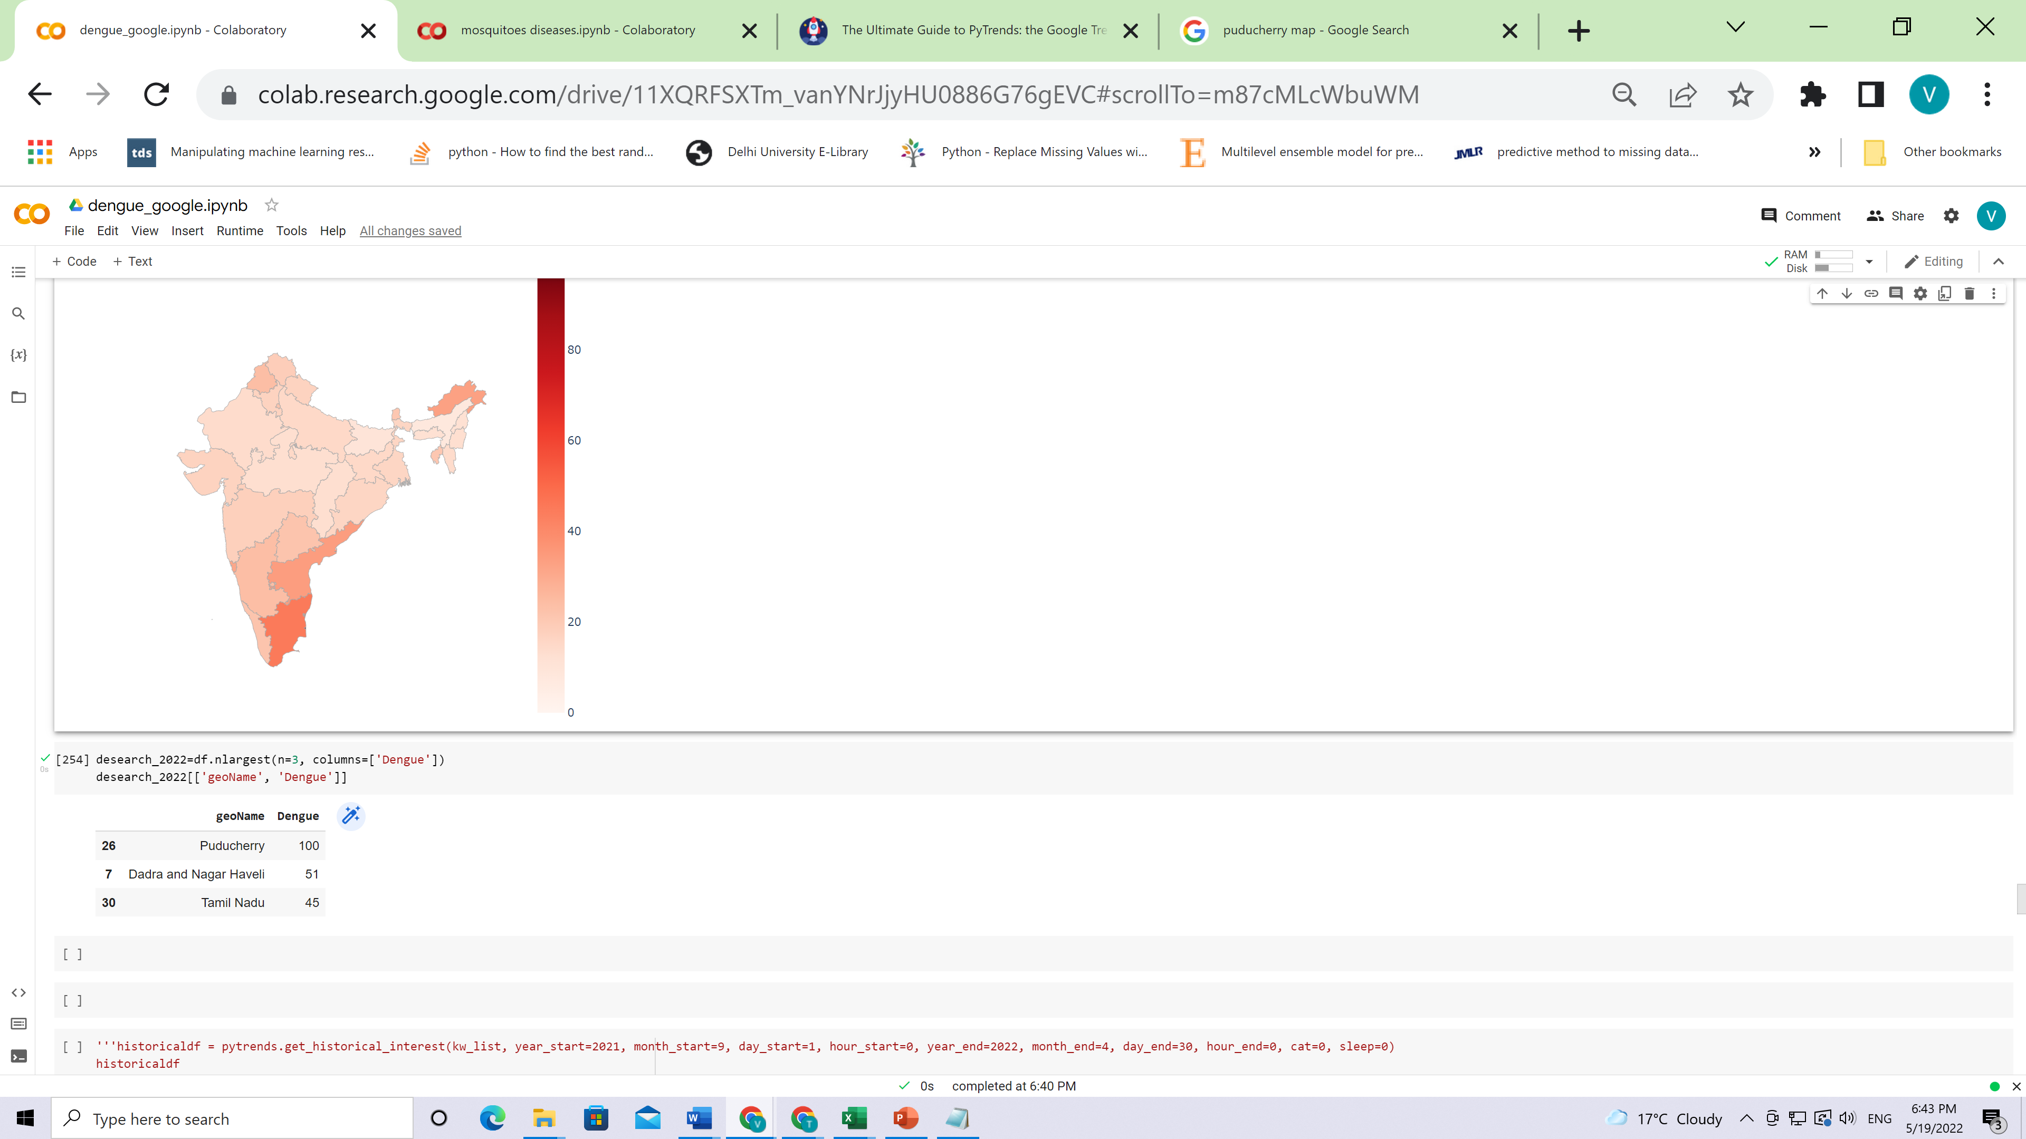
Dengue case in 2022 (till Apr 2022)
CPS Lab, Institute of Informatics and Communication, UDSC

Slide 12
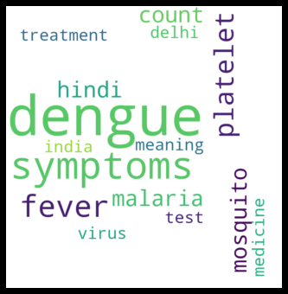
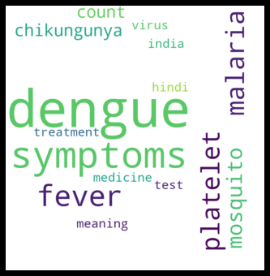
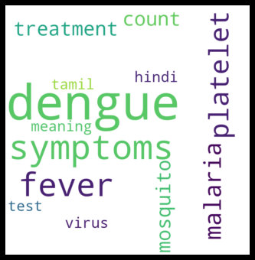
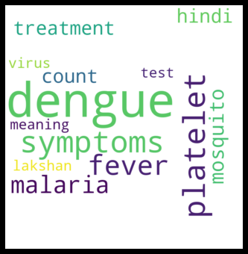
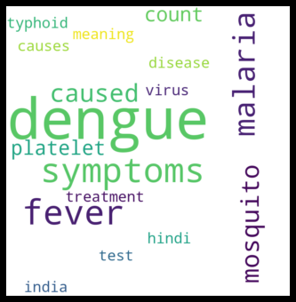
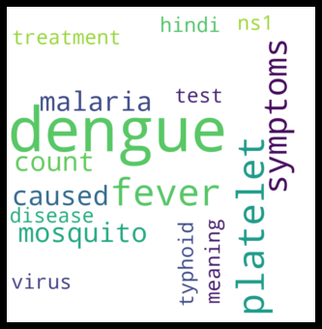
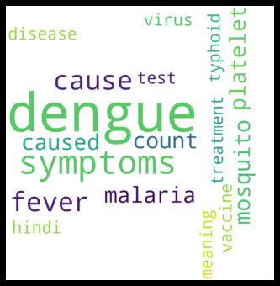
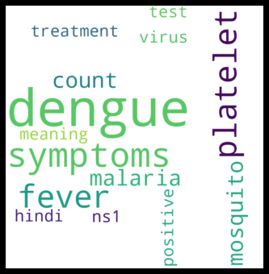


2015
2016
2017
2018
2019
2020
2021
2022
CPS Lab, Institute of Informatics and Communication, UDSC

Slide 13
Findings related to dengue(1)
In 2015 ,top search in wordcloud shows “delhi” and Delhi get the most cases in 2015
In 2016, there is the worst chikungunya outbreak in India so people start searching for it,especially in Delhi.
In 2017 ,Tamil nadu got the second high rank dengue cases ,the top search also mentioned “tamil”wor
In 2018 ,”lakshan” appears in top search.
2019,”ns1” is a test for dengue, introduced in 2006. It allows rapid detection on the first day of fever, before antibodies appear some 5 or more days later. It has been adopted for use in some 40 nations
CPS Lab, Institute of Informatics and Communication, UDSC
Notes:
2016 : (https://www.ncbi.nlm.nih.gov/pmc/articles/PMC5682881/#:~:text=Chikungunya%20fever%20is%20a%20major,massive%20outbreak%20affected%20the%20country.)

Slide 14
Findings related to dengue(2)
2019 ,Karnataka got second most cases and third rank in top search by region.
2020 : “typhoid” starts to appear with dengue keywords.
According to Dengue Typhoid Co-infection: a New Threat case report, there is co-infection with both these diseases is rarely reported and are known to present with overlapping symptoms making the clinical diagnosis difficult.
2020 Punjab is the highest cases and Chandigarh the capital of Panjab, ranked the third top search by region.
2021 : Panjab is the highest cases and the second rank top search by region.
2022 from Jan to Apr 2022 ,Tamil Nādu has the highest accumulated cases and the third rank in top search of google trends.
CPS Lab, Institute of Informatics and Communication, UDSC

Slide 15
3 diseases which appears with dengue : how it related?
Malaria is caused by Plasmodium - a single-celled parasite that is transmitted through the bite of the female Anopheles mosquito. Typically, you can see the symptoms of Malaria 8-25 days after the mosquito bite.
Dengue is also transmitted by a mosquito bite - the Aedes mosquito
. These mosquitoes transmit the disease by biting and spreading the blood of people infected by the Dengue virus, usually in the early morning or at dusk.
CPS Lab, Institute of Informatics and Communication, UDSC

Slide 16
Chikungunya
Chikungunya a is an infection caused by the Chikungunya virus.
This virus is transferred by two species of the same Aedes type mosquitoes.
In India, Chikungunya was never a bigger cause of concern as compared to Dengue, especially in northern India. However, since 2016, there has been an increase in the cases of Chikungunya.
CPS Lab, Institute of Informatics and Communication, UDSC

Slide 17
The common between Chikungunya and Dengue
Dengue and Chikungunya diseases are more common in the tropical and sub-tropical climates. India is one such country where it rains and rains continuously for many months. This is the reason people in India face the threat of these vector-borne diseases.
2.Every year millions of people are affected by Dengue and Chikungunya all across the globe. Thousands in India are also infected with these diseases every year. Deaths are also caused due to mosquito-borne diseases.
CPS Lab, Institute of Informatics and Communication, UDSC

Slide 18
Typhoid
Typhoid : Typhoid fever is a bacterial infection that can spread throughout the body, affecting many organs.
There is co-infection in Typhoid and dengue.
CPS Lab, Institute of Informatics and Communication, UDSC
Notes:
https://pubmed.ncbi.nlm.nih.gov/25653945/

Slide 19
Other words related to Dengue
Platelet Count
Dengue fever can result in a drop in your white blood cell and platelet counts.
The normal platelet count in the body ranges from 1.5 to 4 lacs, this can go down to as low as 20,000 to 40,000 in the case of dengue patients.
This happens because:
Dengue can damage your bone marrow, the platelet-producing centre of the body.
The dengue virus can affect your blood cells and damage your platelets.
Dengue can generate antibodies that destroy platelets.
CPS Lab, Institute of Informatics and Communication, UDSC

Slide 20
Google trends
Top searches
Top searches are terms that are most frequently searched with the term you entered in the same search session, within the chosen category, country, or region. If you didn't enter a search term, top searches overall are shown.
Rising searches
Rising searches are terms that were searched for with the keyword you entered (or overall searches, if no keyword was entered), which had the most significant growth in volume in the requested time period. For each rising search term, you see a percentage of the term’s growth compared to the previous time period. If you see “Breakout” instead of a percentage, it means that the search term grew by more than 5000%.
CPS Lab, Institute of Informatics and Communication, UDSC

Slide 21
References
https://www.godrejhit.com/blogs/differentiate-between-dengue-and-chikungunya
https://www.medanta.org/patient-education-blog/dengue/#:~:text=Dengue%20fever%20can%20result%20in,the%20case%20of%20dengue%20patients.
https://www.medanta.org/patient-education-blog/world-malaria-day-dengue-and-malaria/
https://support.google.com/trends/answer/4355000?hl=en#:~:text=Rising%20searches%20are%20terms%20that,to%20the%20previous%20time%20period.
CPS Lab, Institute of Informatics and Communication, UDSC

Slide 22

Institute of
Informatics &
Communication
THANK YOU
CPS Lab, Institute of Informatics and Communication, UDSC

